Slide 1

Welcome to Our Synod on Synodality
Listening Session
Institute Name
Here

Slide 2
Welcome and Prayer
Welcome ______________________________
Prayer ______________________________
Reader ______________________________
Facilitator ______________________________________

Slide 3


The Process: Dialogue and Discernment
The Purpose of the Listening Session
To LISTEN carefully to each other
To DIALOGUE about experiences and needs
in the Church, the people of God
To DISCERN what the Holy Spirit
is calling the Church to in the 21st Century
Disciplined Process

Slide 4
The Process: Dialogue and Discernment
Don’t try to solve ISSUES – Gathering Information
  After Listening Sessions:
  Congregation and LCWR will look at feedback and strategize around issues and needs
Share YOUR experience of ministry in the Church
  How do you feel?
  How have you been able to participate?
  What needs to move forward?

Slide 5

Listening Session Process
Gathering Prayer and Faith Sharing
Video by Cardinal Tobin
What is this synod on Synodality, and why it is important
3. Explanation of the Process
  Main Facilitator(s)
  Group Facilitator
  Group Scribe
  Breakout Room Discussion  Feedback Handouts
  4. The Core Questions from Pope Francis
    Discussion in Breakout Rooms
    Choose Main Points for Reporting
    5. Thank you and Sending Prayer

Slide 6
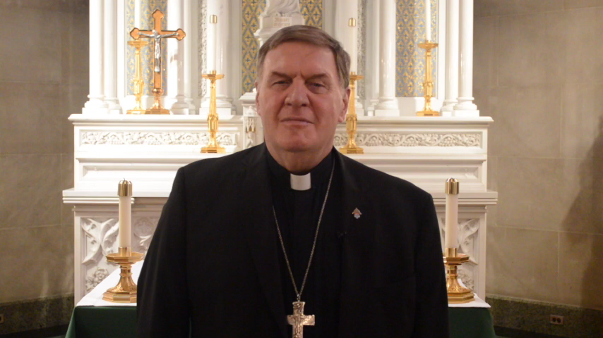
Synod Message from Cardinal Joseph W. Tobin, CSsR

Slide 7
Pope Francis’ Core Question ONE – approximately 25 Minutes
How is this “journeying together” happening today in your religious community and ministry? Recall your experiences
What are the ways you have experienced “walking together” in the Church in your various ministries?
What have been difficulties or obstacles about ministry in the Church for you?

Slide 8
Pope Francis’ Core Question TWO – approx. 25 Minutes
How are we “walking together” as a Church, and what steps does the
Holy Spirit invite us to take in order to grow in our journeying together?
What is the Holy Spirit asking of the Church today?
What do you think Pope Francis most needs to hear from Women Religious?
What are 3 steps you feel the Church needs to take to respond to the Holy Spirit and the needs of today?
1. ___________________________________________________________________________
2. ___________________________________________________________________________
3. ___________________________________________________________________________

Slide 9
Local Questions – 10 Minutes
How are we “walking together” as the Archdiocese of Newark, and what steps does the Holy Spirit invite us to take in order to grow in our journeying together?
How can the Archdiocese of Newark and the Sisters of St. Dominic work together to grow more collaboratively and support each other?
• What are three steps we can take in our Archdiocese to grow more collaboratively for the future?
1. ___________________________________________________________________________
2. ___________________________________________________________________________
3. ___________________________________________________________________________

Slide 10
Leadership Conference for Women Religious - LCWR
In light of all the sharing you heard on the Synod on Synodality theme, Communion, Participation and Mission, what is most important to you that the LCWR feeds back to the synod process?
Please write thoughts on the back of your handout

Slide 11

If there is time…
Feedback from a few groups
Two or three groups can give
a flavor of their discussions
Evaluation of the Time spent together
• How has this discussion given you the opportunity to listen, express and share your own experience of your ministry and the universal Church?
• What is one hope you have for the Church as we continue to grow
and listen to the Holy Spirit?

Slide 12
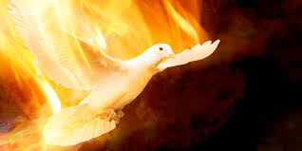
Sending Prayer
Leader Let us take a moment of quiet as we reflect on what we have done here today…
Reader A reading from the Letter of Saint James Jas 1:21-22
  Dearest brothers and sisters:
  Humbly welcome the word that has been planted in you…
  [and] Be doers of the word and not hearers only.
Leader Come Holy Spirit,
we ask you, that by your inspiration,
all of our prayers and actions always begin from you
and inspire others to know you more deeply.
We ask this through Christ our Lord.
All Amen
Leader Let us go forth sharing a sign of peace.

Slide 13
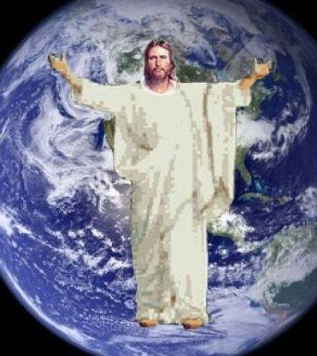
Thank You
For prayerfully reflecting
on how we might grow TOGETHER
and share in the
Mission of Christ

