Slide 1
2023 Local Safe Environment Coordinator Training Guide -Parish
Archdiocese of Newark
Department for the Protection of the Faithful
Office of Child and Youth Protection

Slide 2
Table of Contents
Contact List: Protection of the Faithful department
The Charter for the Protection of Children and Young People
Forward in Faith Pastoral Vision
Assigning a new Local Safe Environment Coordinator
LSEC Responsibilities
Safe Environment Policies
Background check procedures
Virtus
Appendix: Safe Environment documents

Slide 3
Department for the Protection of the Faithful Office of Child and Youth Protection Office of Accompaniment Office of Investigations
Name | Title | Telephone | Email
Karen Clark | Director, Department for the Protection of the Faithful | 973-497-4254 | Karen.Clark@rcan.org
Gina Criscuolo | Coordinator, Office of Accompaniment | 201-497-4210 | Eugenia.Criscuolo@rcan.org
Ralph Lilore | Coordinator, Office Of Child and Youth Protection | 973-497-4578 | Ralph.Lilore@rcan.org
Ana Zsak | Coordinator, Office of Investigations | 973-497-4307 | Ana.Zsak@rcan.org
Marta Nieves | Safe Environment Assistant | 973-497-4329 | Marta.Nieves@rcan.org
Questions? We are here to help!
This Photo by Unknown Author is licensed under CC BY-SA
Notes:
Verify our dept name
Removed Larry and added Stephanie

Slide 4
The Charter for the Protection of Children and Young People
The Charter for the Protection of Children and Young People is a comprehensive set of procedures originally established by the USCCB in June 2002 for addressing allegations of sexual abuse of minors by Catholic clergy. The Charter also includes guidelines for reconciliation, healing, accountability, and prevention of future acts of abuse. It was revised in 2005, 2011, and 2018.
It can be accessed online at the OCYP website.
All LSECs should read the Charter.

Slide 5
Our department is the first pillar of Cardinal Tobin’s “Forward in Faith” Pastoral vision.
It is imperative that we continue to institutionalize the accountability and transparency of the Archdiocese in serving and protecting our faithful. This includes enhancing Archdiocesan policies and processes that ensure the protection of minors and seminarians. We must work collaboratively at all levels — including clergy, laity, government and law enforcement, victims and their families, and the faithful-at-large — to maintain and reinforce these policies.
https://forward.rcan.org/

Slide 6
How to assign a new Local Safe Environment Coordinator.
The pastor will send an email to Karen Clark (karen.clark@rcan.org) to advise the name and email address of the new LSEC.
The Safe Environment Compliance team will give the LSEC the administrative access in Virtus, and add the person to our LSEC list.
The new LSEC will review the training guide and the most recent Zoom training, available on the LSEC portion of the Protection of the Faithful Website.

Slide 7
LSEC Responsibilities
Ensure all employees and volunteers (in ministry with minors) are safe environment compliant.
Maintain the required safe environment files.
Communicate safe environment-related information to all who are required to comply.
Record the compliance documents’ dates in the Virtus database.
Submit the USCCB annual Youth Protection audit (December)and the Empowering God’s Children audit (April).
Communicate with sect@rcan.org to submit background checks and re-checks.
Keep the Virtus database up to date.
Review employee and volunteer training status monthly.

Slide 8
All LSEC’s are required to complete PGC recertification online.
To read the monthly bulletin:
Log into your Virtus account>Training Bulletins>Click link to Read the Bulletin>answer the question at the end.
LSEC will read a bulletin every month
Notes:
Click on the bulletin title, read it, and submit an answer to the question at the end.
Take the annual recertification module every year, print and file your certificate.

Slide 9
All LSEC’s are required to complete PGC recertification online.
To complete the annual module:
Log into your Virtus account> “Current Training”>Click on “You Have “X” Modules Assigned”.
Once the module is complete, print the certificate and place it in your file. LSEC will complete one module per year.
Notes:
Click on the bulletin title, read it, and submit an answer to the question at the end.
Take the annual recertification module every year, print and file your certificate.

Slide 10
The LSEC name and contact information is posted on the Home tab in Virtus.
The LSEC name should be posted in the bulletin and is posted on the Home page*.
Employees and volunteers should know that the LSEC is the person that should be contacted first with any Safe Environment questions.
*If the information is incorrect, please contact sect@rcan.org to submit the correct information.

Slide 11
Archdiocese of Newark Office of Child and Youth Protection Safe Environment Policies
This Photo by Unknown Author is licensed under CC BY-SA

Slide 12
These individuals need all 4 safe environment documents.
All employees
All ushers (exception: money collectors)
All chaperones
All volunteers who could have unaccompanied contact with minors at any time (scout unit leaders, scout unit adult volunteers, catechists, coaches, peer ministers, altar server coordinators, etc.)
Anyone who could groom a minor and/or have time alone with them – (using the ‘path test’)
If you are not sure, contact the OCYP* for help! (*Office of Child and Youth Protection at sect@rcan.org)

Slide 13
These steps must be done before a new hire or volunteer may start.
Step 1
Step 2
Step 3
The new employee or volunteer has 30 days from the day they start to attend a PGC live class and provide their certificate to the LSEC. LSEC will verify that the PGC certificate is approved in Virtus.
Protection of the Faithful will enter the new employee/volunteer documentation to the required document tab in Virtus (Application/Code of Conduct)
An employee receives a conditional offer of employment, pending the outcome of their background check.
A volunteer is accepted (but may not start) pending the outcome of their background check.
The employee or volunteer completes an application and a Code of Conduct.
The LSEC submits the application, the Code of Conduct sheet and a cover sheet to sect@rcan.org for the running of a background check.
Once the background check has cleared, Protection of the Faithful updates Virtus and sends a background check letter to the person and the LSEC.

Slide 14
Can Volunteers or Employees bring their documentation from one location to another?
Employee-Parish A | Employee-Parish B | No: Employees need new documentation when they change locations.
Employee-Parish A | Volunteer-Parish B | Yes: Employees may bring their documentation to a new location if they will be a volunteer in the new location.
Volunteer-Parish A | Volunteer-Parish B | Yes: Volunteers can bring their documentation from one parish to another.

Slide 15
All employees and volunteers (in ministry with minors) must complete re-training in child sexual abuse awareness every 5 years.
Live Class Options
(Good for 5 years)
PGC (3 hours) everyone must take this for their first class.
Keeping the Promise Alive (90 minutes)-recertification only
Vulnerable Adults (90 minutes)-recertification only (by request)
Each class has a certificate
The date of re-certification is 5 years from the actual date on the certificate.
For example, a certificate dated 6/15/2023 will expire on 6/15/2028.
Online Recertification
(Every year)
Every month: read the bulletin and answer question
Every year: complete the online module (45 minutes) and print certificate
If a person has taken BOTH Protecting God’s Children and Keeping the Promise Alive, they can take a one-hour online module – contact sect@rcan.org to do any of the online options
Notes:
Moved the yellow box under the Live Class section for clarity

Slide 16
A Parish Employee needs all 4 items in their individual folder.
Application (2013 Employee or 2019 Employee) especially the last two pages. All pages must be complete, initialed and signed. *If an employee has an application prior to 2013, they only need to complete the last 2 pages of the 2013 application. Signatures and initials must be done by hand.
2012 or 2019 Code of Conduct (Page 23), either give them a printed copy to read, or the website where they can read it, print and sign the last page. The hardcopy must be hand signed; it cannot be electronically signed.
PGC certificate and any/all recertification certificates.
Letter(s) saying they passed a background check (every 5 years).
Parish employees must complete an application, background check and Code of Conduct for each location in which they are employed.

Slide 17
A Parish volunteer (in ministry with minors) needs all 4 items in their individual folder.
Application (2012 volunteer) especially the last two pages. Hand-initialing and signing are required.
2012 or 2019 Code of Conduct (Page 23), either give them a printed copy to read, or email the link to the website where they can read it, print and sign the last page. The hardcopy must be hand signed; it cannot be electronically signed. *New volunteers will also be asked to sign this electronically when they sign up for their initial training in Virtus, but you must have the Archdiocesan hardcopy in your files.
PGC certificate and any recertification certificates.
Letter(s) saying they passed background check OR the NJ DOE Applicant Approval Employment History document saying they passed fingerprinting (done once) because they are currently working in a NJ school. If they are not an active school employee, they must have a Sterling Volunteers background check and letter.
Notes:
The last page of the volunteer application may not be altered. Remove sentence highlighted in red and suggest a template with that question.

Slide 18
Bereavement Facilitators and 3rd Party contractors have abbreviated requirements.
Bereavement Facilitators or Separated/Divorced Support Facilitators
Require only a volunteer application and a background check.
PGC certification is not required.
3rd party contractors in a parish (e.g., cleaning service, maintenance company, landscapers)
Get written assurance (on contractor’s company letterhead) that their employees have been background screened
PGC certification is not required

Slide 19
Catholic Scouting Policies changed in 2021; all Chartered troops and packs are ministries and are treated as such.
Effective 2/1/2021, all adult leaders and adult volunteers of chartered Scout Units must meet all the requirements of the Archdiocesan Safe Environment protocol.
Pastors who choose to charter/recharter must be actively engaged in the oversight of scout troop activities and the selection of troop leadership.
A current copy of the Charter must be on file at the parish.
Complete details are available on the Catholic Scouting webpage https://www.newarkoym.com/boy-scouts

Slide 20
Safe Environment Procedures

Slide 21
The LSEC will be able to see the completed background check date in the Virtus record for the employee or volunteer.

Slide 22
Virtus is your go-to place for compliance; you have Administration authority to your users.

Slide 23
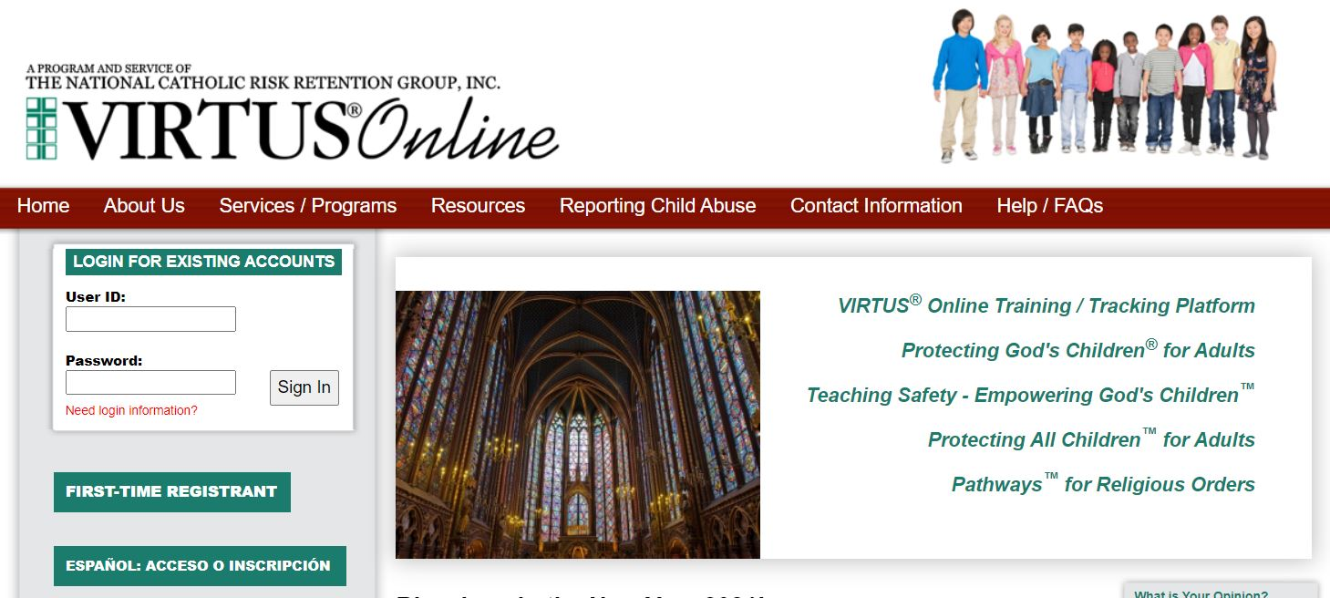
Let’s take a look at how you’ll be using Virtus.
Virtus functions
Administration Tab
How to run a Compliance Report
Updating the parish list
How to print a PGC certificate
Updating individual records

Slide 24
Virtus allows users to sign themselves up for class, as well as allows you to manage compliance.
New User sign up
Every employee and volunteer (in ministry with minors) will create an account in Virtus to sign up for a PGC class. The account stays with them and will be used to sign up for recertification classes and/or complete online recertification requirements.
Database
You can run monthly reports to review compliance, as well as determine that all active users are represented, and inactive or deceased users are not in the active user list

Slide 25
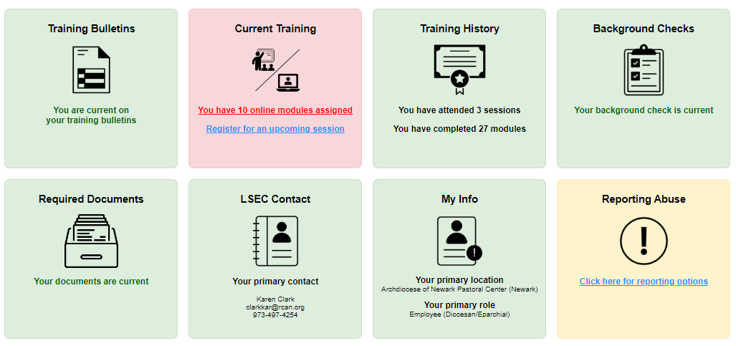
The Virtus Home tab provides an overall look at compliance for each user.

Slide 26
Virtus “Home” Tab explanation.
Users who have opted into online recertification will have all 8 boxes. Box 1 and Box 2 provide access to the monthly bulletins and the annual modules.
Users who are not opted into online recertification will only have 6 boxes (the Training History, Background Checks, Required Documents, LSEC Contact, My Info and Report Abuse boxes).
A Green box means they are compliant with safe environment requirements.
A Red box means they are not compliant. If a user has opted into online recertification, they can click into Box 1 and/or Box 2 and update their training.
Users who have a red Background checks or Required Documents box will need to contact their Local Safe Environment Coordinator to determine what must be updated.

Slide 27
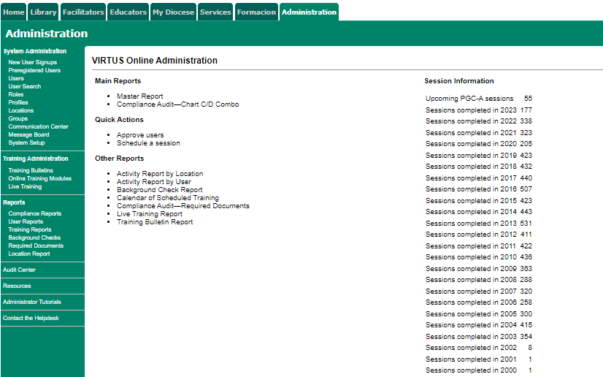
Select “Users” to access parish-specific Virtus lists in the Administration Tab.
Notes:
Add screen shot of the Inactive box

Slide 28
Select “User Search” and all records in the Archdiocese can be searched.
To add a user from a different location to your location, email the name, username and location to
sect@rcan.org and the OCYP will add the user to your location.

Slide 29
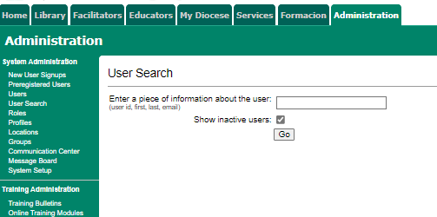
Select “Show Inactive users” to capture everyone in the parish or Archdiocese.

Slide 30
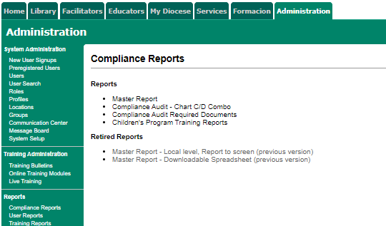
Compliance reports will show who needs recertification and background rechecking, if the data is in Virtus.
LSEC should run a Master Compliance report monthly to review the following:
Background check dates
PGC certification dates
“Pending” users
“Suspended” users
Online recertification compliance
Input any missing dates for compliance items

Slide 31
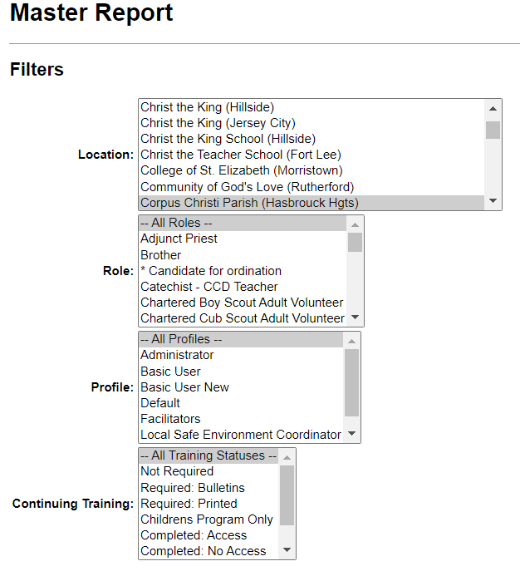
How to Run a Master Compliance Report Step 1> Select the Filters
Location>Your specific location
Role>All Roles
Profile>All Profiles
Continuing Training>All Training Statuses

Slide 32
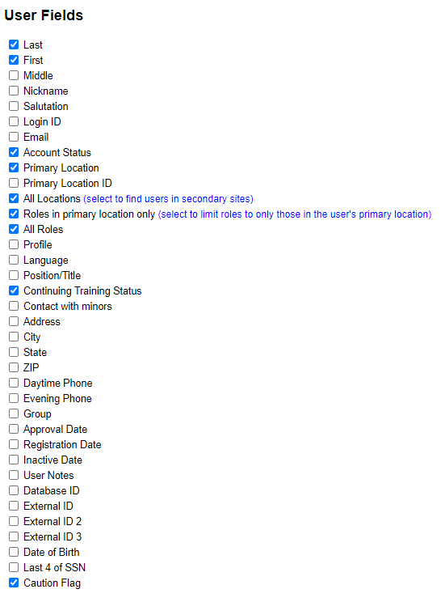
Step 2 > Select the User Fields
LSEC can select any of the fields listed if you need additional information (email address, telephone). If the information is not in Virtus, it will not appear on the report.
Account Status will indicate if user is Active, Inactive or Pending.
The Caution Flag will provide information regarding issues that need to be addressed by the OCYP. If you see information in the Caution Flag field, please contact the OCYP by email sect@rcan.org.

Slide 33
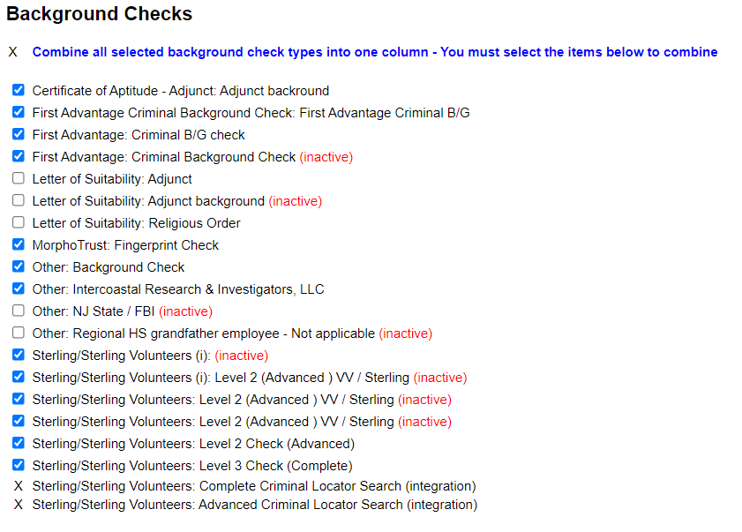
Step 3> Select the Background Checks fields
To view older background check information, simply select more fields.

Slide 34
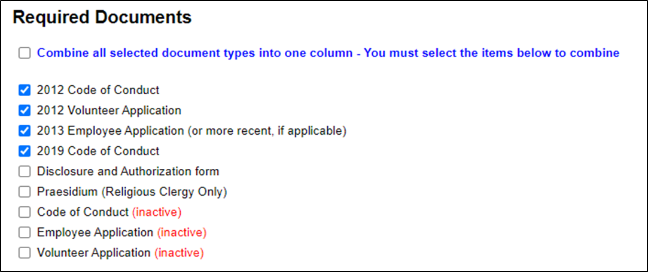
Step 4> Select the Required Documents fields
Employees or volunteers starting on or after January 1, 2019, will complete the 2019 Code of Conduct.
New employees starting after September 2019 will complete the new September 2019 Employee Application.
Notes:
Updated screen shot for Required documents

Slide 35
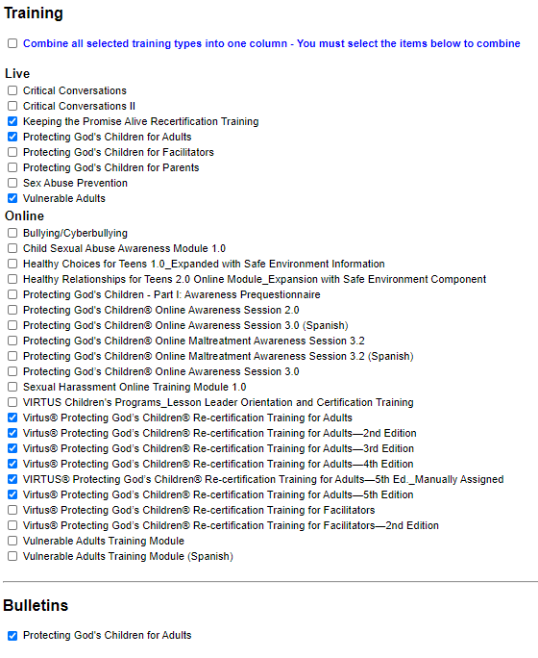
Step 5> Select the Training fields
Notes:
Updated the smart graphic to match on both guides

Slide 36
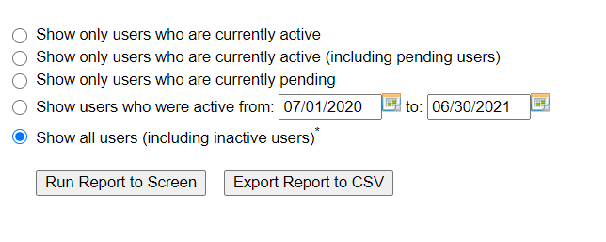
Step 6> Select the report period and report format.
Run Report to Screen – not recommended for printing. Good option to review the report and make edits to individual records.
Export Report to CSV- report can be saved in Excel and is easier to review and work with the data.
Notes:
Updated screen shot

Slide 37
“Run Report to Screen” looks like this.
Run Report to Screen will allow access to each user record. Click anywhere there is a blue hyperlink, and it will open the individual user record. Edits can be made directly in the user record.

Slide 38
“Export Report to CSV” looks like this. It can be saved to Excel.

Slide 39
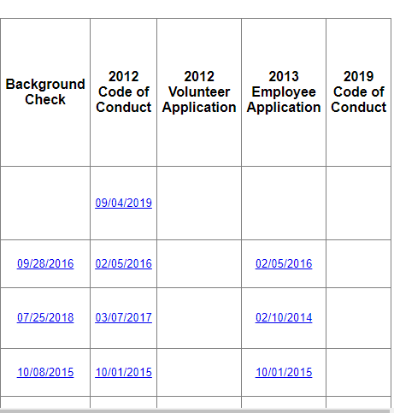
There should be dates from your files for the Code of Conduct, application and background check so the information is retained in the Virtus database.
Background checks:
If volunteer runs it at integration, the date will automatically populate.
Otherwise, the date must be manually entered.
Application dates will be manually entered by POTF when we receive packet.
If a field is blank, check may not have been done – check the files.

Slide 40
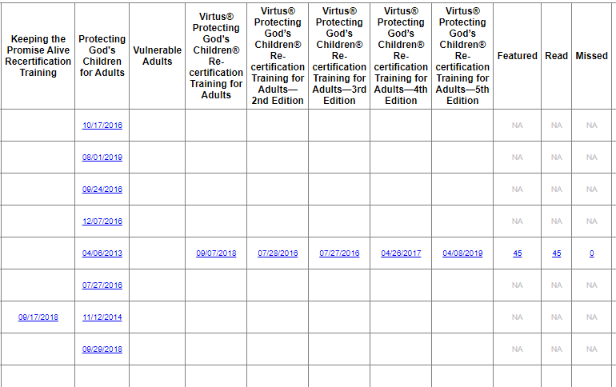
The Training section of the report shows the training dates, whether users have opted in for online recertification, and if they are compliant.
This person recertified by taking a live class
This person is recertifying online and is up to date with both the annual module and the monthly bulletins. They are up to date because they have “0” Missed bulletins.

Slide 41
Here are some sample people; let’s take a look.
Sally Smith- Suspended because she missed 60 months of bulletins. Users who opt in for online recertification and do not keep up with the monthly bulletins and annual module get Suspended after 18 missed bulletins. They have 2x to try and keep up. After that, they must attend a live class to recertify. Contact sect@rcan.org to have person set up or re-set up for the articles or the module.
Don Brown-Pending because he signed up to attend PGC but did not receive credit (see next slide for examples). Contact sect@rcan.org for assistance.
Ruben South- PGC certification expired on 11/17/2018. He must recertify.

Slide 42
What is the difference between Awaiting Approval (Pending) and User (also shows as Active)?
Awaiting Approval (Pending on the Compliance Report) means that they enrolled in Virtus to attend PGC, but never had their enrollment approved because:
They didn’t show up for the class
The sign in sheet never made it to the Archdiocese
The class hasn’t happened yet
They walked into class and enrolled later, and didn’t let us know they had done that
Once they get approved by the OCYP, their status changes to Active User (Active on the Compliance Report)

Slide 43
For the Virtus lists, it’s important to get down to only those people who are active in the parish.
Get lists of current people from the ministry heads, coaches, Scout Units, etc.
Active people are the only ones who should be on your Virtus lists and in your Active Files (others can be filed elsewhere but must be retained)
Virtus List Management:
Duplicates: Email the names of any duplicates on your list to the OCYP, and we will delete them or merge them.
For any individuals who are Pending/Awaiting Approval, email the names to the OCYP for resolution
Change status from Active to Inactive (or vice versa)
Notes:
Pending/Awaiting Approval people- clarify this point because shouldn’t only the OCYP be responsible for this?
Recommendation: For any individuals who are Pending/Awaiting Approval, email the names to the OCYP for resolution.

Slide 44
How to Update a User Role and Location.
If an individual is not volunteering at this point: Change the Account status (in the yellow area) to Inactive – but ONLY if yours is the only location in their record. Account status can also be changed back to “Active” at any time.
If the individual is at multiple locations, just end their service at your location by clicking on the red stop sign . Clicking the red stop sign will completely remove the individual from your location.
If an individual is temporarily inactive, change their Role to “Z-Missing Role”. Once they return, change the role to the correct new role.
Notes:
Added: Note: LSEC’s only have access to their main location in Virtus. If access to an additional location is needed (for parishes that have a school close by), contact the OCYP at sect@rcan.org.

Slide 45
To Change the “Role” or “Location” Click on the blue hyperlink
LSEC’s only have access to their main location in Virtus and will only be allowed to make changes to individuals assigned to that location.
If access to an additional location is needed (for parishes that have a school close by), contact the OCYP at sect@rcan.org.

Slide 46
Select the new role from the drop-down menu Click “Save with History” Complete the same process for “Location” if necessary

Slide 47
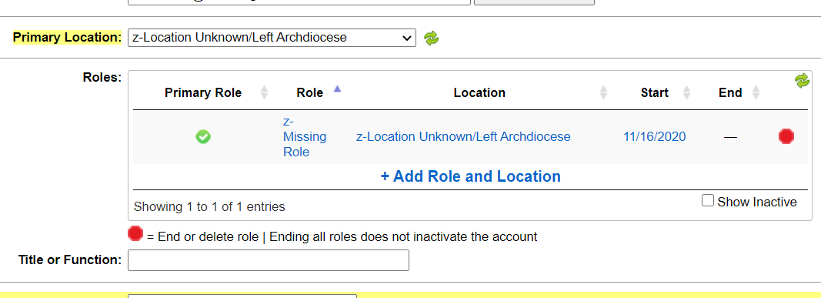
Change the Role and the Location for any individuals no longer at your location, deceased, or have permanently left the Archdiocese.

Slide 48
If a person took Protecting God’s Children in another diocese, they must have their record transferred to Newark. Contact the OCYP for help.
Each diocese has its own Virtus system – the OCYP does not have access to other dioceses (Metuchen, Paterson, etc.)
The OCYP can do the following:
Have the PGC record transferred to Newark (email a copy of the PGC certificate to the OCYP).
If they still volunteer in the other diocese, the OCYP will have the PGC record duplicated in Newark.
Email the name and copy of the certificate to the OCYP (email to sect@rcan.org) so we can resolve.
Notes:
Added OCYP email address to last bullet point

Slide 49
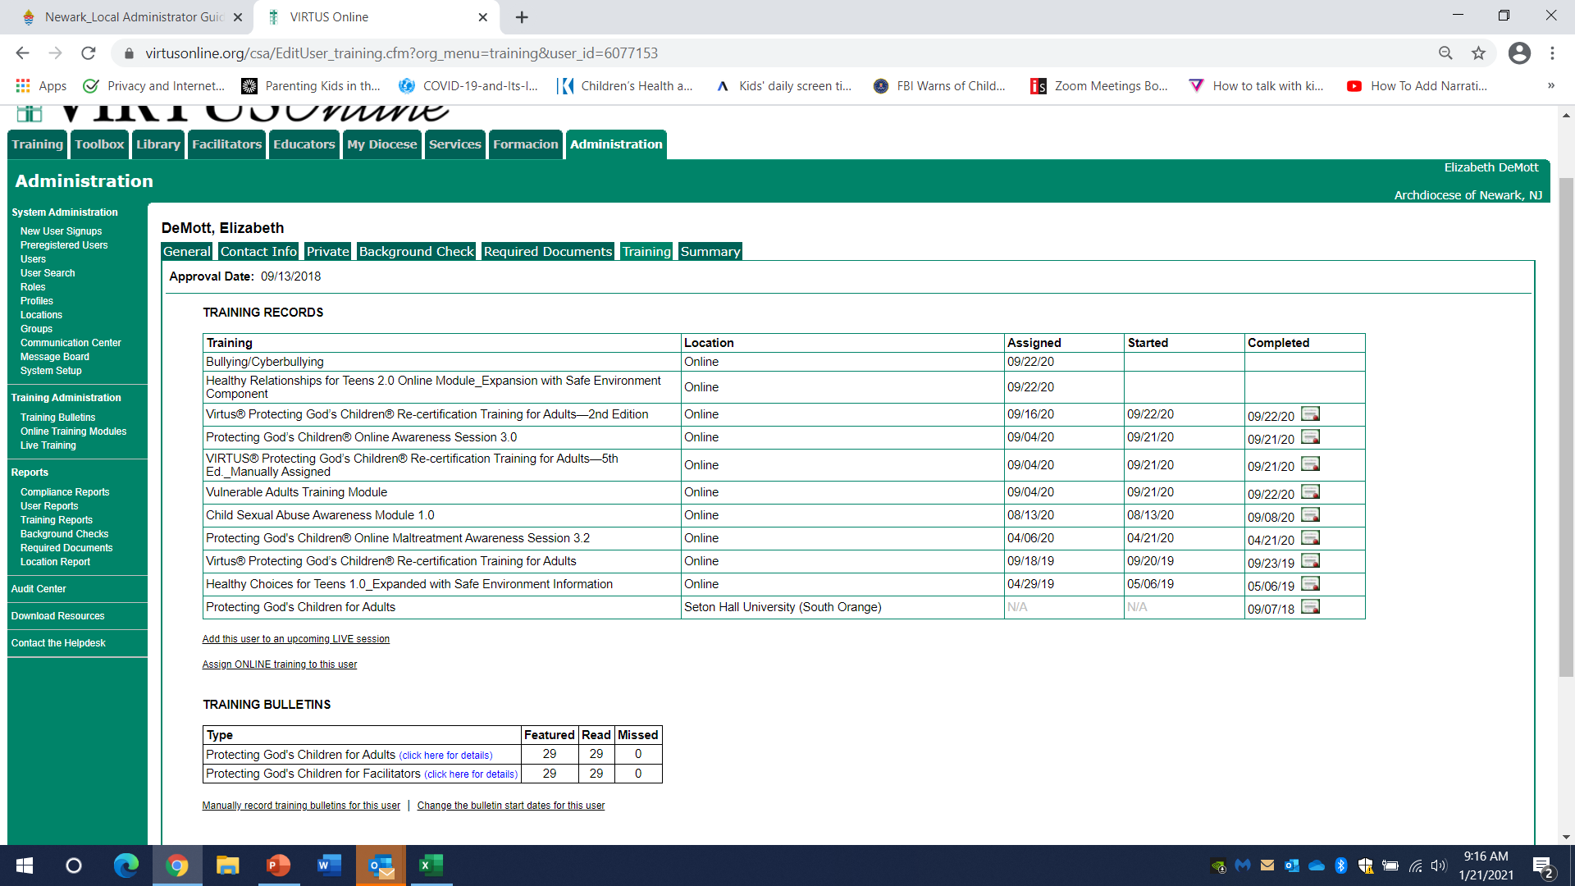
PGC training certificates can be printed from Virtus.
If you need a certificate, print it from the Training tab by clicking the little certificate icon next to the word “Approved.” LSEC can sign and file it.

Slide 50
Once we receive the packet for the background check, we will enter the dates from the required documents and background check into Virtus.
The date the employee/ volunteer application was signed.
The date the Code of Conduct was signed.
The date the background check was completed.

Slide 51
Volunteers who completed their background check themselves through Integration (when they first signed up in Virtus) will have it already entered in Virtus.
Send us the packet for these users, which gives us permission to view the results and write a letter.

Slide 52
Sterling costs vary depending on where the person has lived, and if the person possesses a Social Security Number.
All volunteers and employees are required to provide their Social Security Number and Date of Birth. Cost for these checks through Sterling is $21.20.
For those who don’t have a Social Security Number, you MUST vet them locally, and the charge for the check is about $10.
Any county that charges for access to their database will be charged separately – for many local NY Counties this is $95 Per Alias
Volunteers can contribute to the cost if you ask us to send them a link directly, and they complete their own background check.
Employees who want to run their own repeat (not initial) background check can be sent a link directly by our team.
Parish is invoiced monthly for the costs of the background checks; parish is responsible for the cost

Slide 53
All active parish employees and volunteers must be re-screened every 5 years.
Run a Master Compliance report to see who needs a background check at the beginning of each calendar year or catechetical year (assuming the dates are in Virtus)
Make sure you have an application on file and that all pages are filled out and initialed where indicated, specifically the last 2 pages. If the “Notice Regarding Credit Reporting Agency Check” page is not initialed, the background check cannot be run.
Send a packet (cover sheet, application, Code of Conduct, and PGC certificate) to sect@rcan.org or fax to (973)497-4001

Slide 54
Appendix- Sample Documents
2012 Volunteer Application
2013 Employee Application
2019 Employee Application
2019 Code of Conduct
Background check letter
Copies of any documents are available by emailing sect@rcan.org

Slide 55
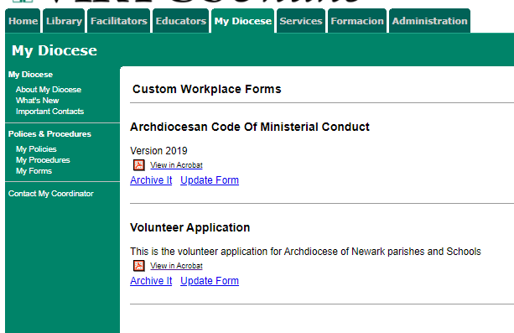
The volunteer application and Code of Conduct are also included in the “My Diocese” tab in Virtus, under “Custom forms.”
Copies of any documents are available by emailing sect@rcan.org

Slide 56
All Volunteers will complete the 2012 Volunteer application.
Make sure application is signed, dated and initialed.
Volunteer must provide an Emergency Contact.
There are 3 questions regarding Criminal History on page 3 of the application- these must be answered “Yes” or “No”! A response of “N/A” is not acceptable.

Slide 57
The declaration page must be hand-initialed, signed and dated.
All lines must be initialed (checkmark is not valid).
LSEC will review and ensure all information is complete.

Slide 58
The last page must also be hand-initialed, and we do not do a credit check.
Can the Archdiocese obtain financial information about me? No. We are barred from any access to your financial information. In fact, if anyone accesses your credit report without your permission, that is a violation of law, and you should notify the
Federal Trade Commission .
Once the volunteer initials this page, their background check can be run at anytime.
Notes:
I pulled the question from the Archdiocese of New York website. The verbiage can be changed if it isn’t appropriate to include here.

Slide 59
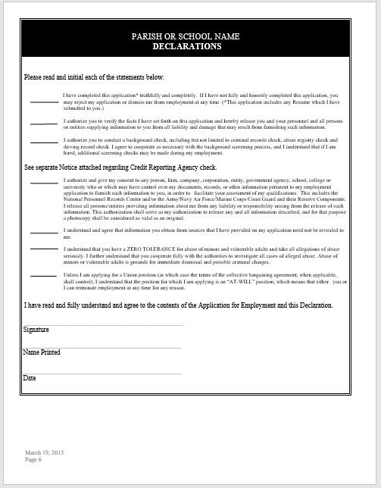
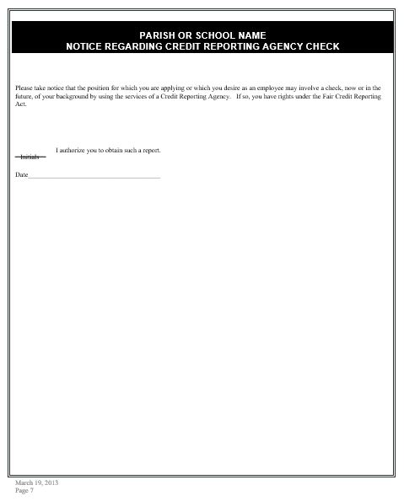
Employees who have an application prior to 2013, must complete the last 2 pages of the 2013 Employee application.
Correct application date is March 19, 2013.

Slide 60
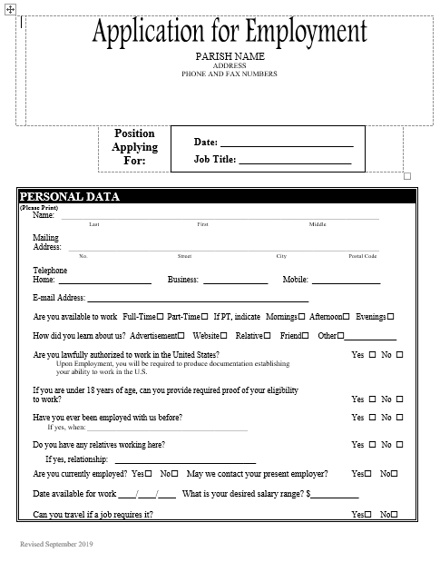
Parish employees who start after September 2019 must complete the new September 2019 Application.
New Jersey State law now prohibits employers from requesting salary history from candidates.
The salary history portion has been deleted from the revised application.
Every Parish
must insert your specific Parish name, logo and address. The RCAN logo and address must not appear on your application.
Correct application date is March 19, 2013.

Slide 61
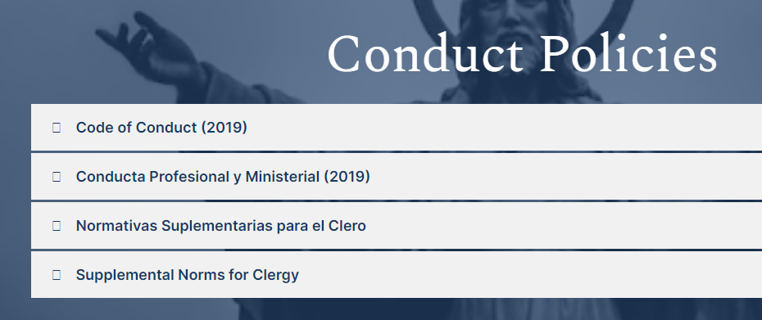
2019 Code of Conduct (in English and Spanish) can be accessed on rcan.org>Protect/Report>FAQ
All employees and volunteers must read the Code of Conduct and sign page 23. The signed copy will be retained in the employee or volunteer file.
Notes:
Updated header, changed screen shot

Slide 62
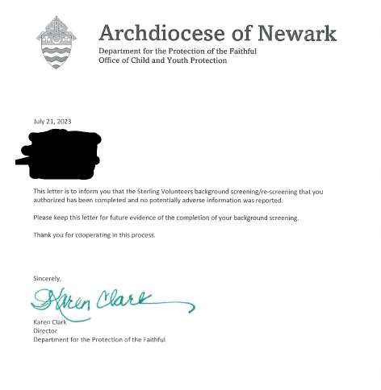
Each employee and volunteer (who has a background check) will receive a letter from our team (once you’re centralized).
Employees and volunteers are required to have this letter in their file as proof that the background check was run.

Slide 63
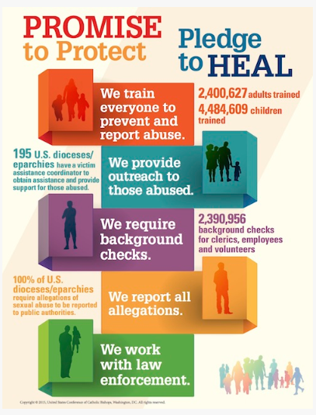
Thank you for protecting the Faithful!

