Slide 1

Local Safe Environment Coordinator Training Guide- Archdiocesan Schools
2023
Department for the Protection of the Faithful
Office of Child and Youth Protection

Slide 2

Table of Contents
Contact List: Protection of the Faithful department
The Charter for the Protection of Children and Young People
Forward in Faith Pastoral Vision
Assigning a new Local Safe Environment Coordinator
Safe Environment Compliance Reviews
Local Safe Environment Coordinator job description and role outline
Safe Environment policies
Safe Environment procedures
  How to use VIRTUS
  NJ DOE Fingerprint requirements
  Sterling/Sterling Volunteer Background checks
Empowering God’s Children Audit
Appendix: Safe Environment documents

Slide 3
Department for the Protection of the Faithful
Office of Child and Youth Protection
Office of Accompaniment
Office of Investigations
Name | Title | Telephone | Email
Karen Clark | Director, Department for the Protection of the Faithful | 973-497-4254 | Karen.Clark@rcan.org
Gina Criscuolo | Coordinator, Office of Accompaniment | 201-497-4210 | Eugenia.Criscuolo@rcan.org
Ralph Lilore | Compliance Officer, Office Of Child and Youth Protection | 973-497-4578 | Ralph.Lilore@rcan.org
Ana Zsak | Investigator, Office of Investigations | 973-497-4307 | Ana.Zsak@rcan.org
Marta Nieves | Safe Environment Assistant | 973-497-4329 | Marta.Nieves@rcan.org
Questions? We are here to help!
This Photo by Unknown Author is licensed under CC BY-SA
Notes:
Verify our dept name
Removed Larry and added Stephanie

Slide 4

The Charter for the Protection of Children and Young People
The Charter for the Protection of Children and Young People is a comprehensive set of procedures originally established by the USCCB in June 2002 for addressing allegations of sexual abuse of minors by Catholic clergy. The Charter also includes guidelines for reconciliation, healing, accountability, and prevention of future acts of abuse. It was revised in 2005, 2011, and 2018.
It can be accessed online at the Protection of the Faithful Web site.

Slide 5
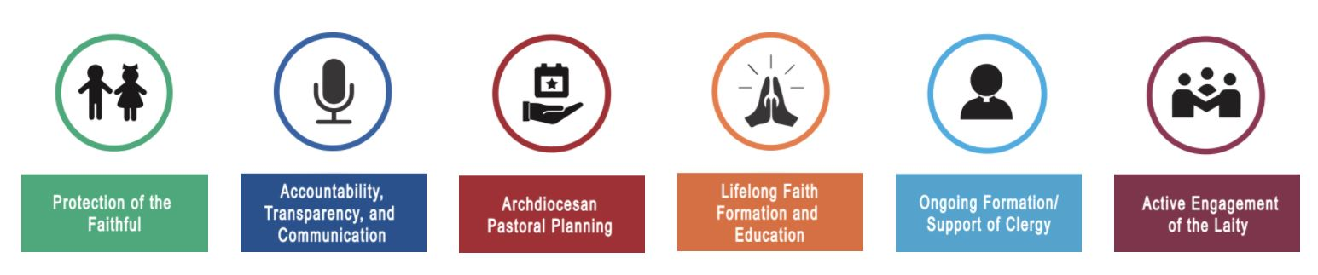
Our department is the first pillar of Cardinal Tobin’s “Forward in Faith” Pastoral vision.
It is imperative that we continue to institutionalize the accountability and transparency of the Archdiocese in serving and protecting our faithful. This includes enhancing Archdiocesan policies and processes that ensure the protection of minors and seminarians. We must work collaboratively at all levels — including clergy, laity, government and law enforcement, victims and their families, and the faithful-at-large — to maintain and reinforce these policies.
https://forward.rcan.org/

Slide 6
Assigning a new Local Safe Environment Coordinator.
The principal will send an email to Karen Clark (karen.clark@rcan.org) to advise the name of the new LSEC.
The new LSEC will review this manual and any recent Zoom recordings on the LSEC section of the website.
The Office of Child and Youth Protection will set the new LSEC up with Administrative authority and add their name to the LSEC list

Slide 7
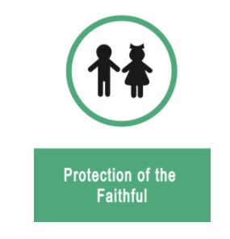
LSEC Responsibilities
Ensure all employees and volunteers (in ministry with minors) are safe environment compliant.
Maintain the required safe environment files.
Communicate safe environment-related information to all who are required to comply.
Keep the Virtus database up to date.
Record the compliance documents’ dates in the Virtus database.
Submit the USCCB annual Youth Protection audit (December) and the Empowering God’s Children audit (April).
Communicate with sect@rcan.org to submit background checks and re-checks.
Review employee and volunteer training status monthly.

Slide 8
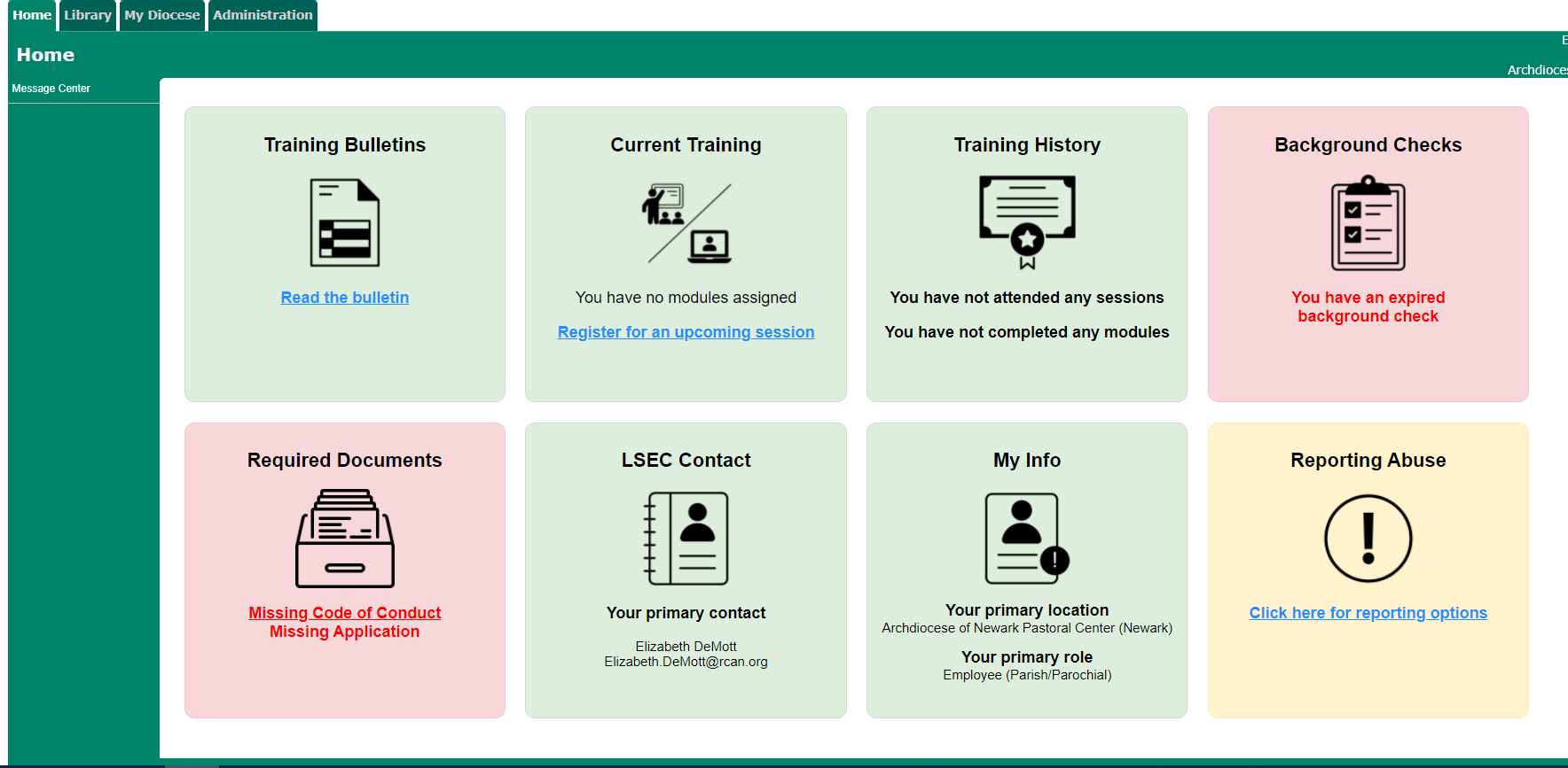
All LSEC’s are required to complete PGC recertification online.
To read the monthly bulletin:
Log into your Virtus account>Training Bulletins>Click link to Read the Bulletin>answer the question at the end.
LSEC will read a bulletin every month
Notes:
Click on the bulletin title, read it, and submit an answer to the question at the end.
Take the annual recertification module every year, print and file your certificate.

Slide 9
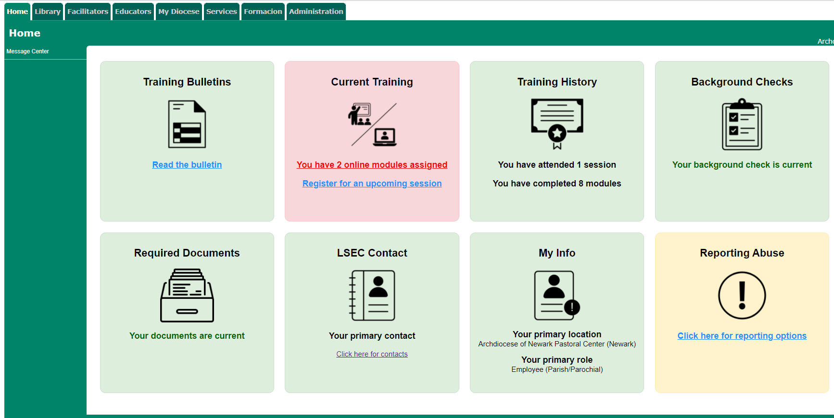
All LSEC’s are required to complete PGC recertification online.
To complete the annual module:
Log into your Virtus account> “Current Training”>Click on “You Have “X” Modules Assigned”.
Once the module is complete, print the certificate and place it in your file. LSEC will complete one module per year.
Notes:
Click on the bulletin title, read it, and submit an answer to the question at the end.
Take the annual recertification module every year, print and file your certificate.

Slide 10
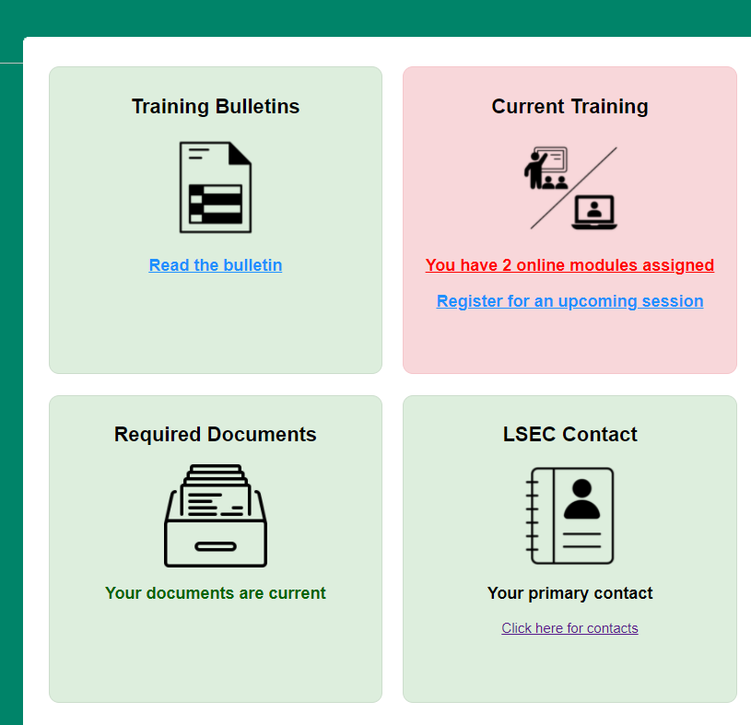
The LSEC name and contact information is posted on the Home tab in Virtus.
The LSEC name should be posted in the bulletin and is posted on the Home page*.
Employees and volunteers should know that the LSEC is the person that should be contacted first with any Safe Environment questions.
*If the information is incorrect, please contact sect@rcan.org to submit the correct information.

Slide 11

Archdiocese of Newark
Office of Child and Youth Protection
Safe Environment Policies
This Photo by Unknown Author is licensed under CC BY-SA

Slide 12
These individuals in a school need all 4 safe environment documents:
  All staff with Ministerial Agreements or Letters of Hire
  Substitute Teachers, Temporary Staff employed by the school for Short Term Project, or Program
  All volunteers who could have unaccompanied contact with children at any time (class parents, coaches, HSA members, tutors)
  Anyone who could groom a minor and/or have time alone with them – your discretion (using the ‘path test’)
  If you are not sure, contact the OCYP* for help! (*Office of Child and Youth Protection at sect@rcan.org)

Slide 13
These things must be done before a new hire or volunteer may start.
Step 1
Step 2
Step 3
The new employee or volunteer has 30 days from the day they start to attend a PGC live class and provide their certificate to the LSEC.
OCYP will enter the new employee/volunteer documentation in Virtus.
An employee receives a conditional offer of employment, pending the outcome of their criminal background check (fingerprinting).
A volunteer is accepted (but may not start) pending the outcome of their background check.
The employee or volunteer completes an application and a Code of Conduct.
The LSEC submits the application, the Code of Conduct sheet and a cover sheet to sect@rcan.org for the running of a background check if the fingerprints won’t be done in time.
Once the background check has cleared, OCYP sends the background check letter to the volunteer and copies LSEC.
The employee completes NJ DOE fingerprint process or archive process.

Slide 14
Can employees or volunteers bring their documentation from one location to another?
School Employee- School A | School Employee-School B | No: All school employees must complete new documentation when moving and have their fingerprints correctly archived/transferred to their new location.
Volunteer-School A | Volunteer-School B | Yes: Volunteers can bring their documentation from one school to another.

Slide 15
A School Employee needs all 4 items in their individual folder.
Application (2013 employee or 2018 employee if they were hired after 6/1/2018 or September 2019 if hired after 9/1/2019) especially the last two pages. All pages must be complete, initialed and signed. *If an employee has an application prior to 2013, they only need to complete the last 2 pages of the 2013 application.
2012 or 2019 Code of Conduct (Page 23), either give them a printed copy to read, or the website where they can read it, print and sign the last page. The hardcopy must be hand signed; it cannot be electronically signed.
PGC certificate and any recertification certificates.
NJ DOE Applicant Approval Employment History document saying they passed fingerprinting (done once) because they are currently working in a NJ school. The History must be correctly archived to their current school location. This can be done on the NJ DOE website.

Slide 16
A School Volunteer needs all 4 items in their individual folder.
Application (2012 volunteer) especially the last two pages. The LSEC may add a question at the end about whether they have lived in New York. This is needed to run the correct type of background check.
2012 or 2019 Code of Conduct (Page 23), either give them a printed copy to read, or email the link to the website where they can read it, print and sign the last page. The hardcopy must be hand signed; it cannot be electronically signed. *New volunteers will also be asked to sign this electronically when they sign up for training in Virtus, but you must have the Archdiocesan hardcopy in your files.
PGC certificate and any recertification certificates.
Letter(s) from school saying they passed background check from Sterling Volunteers (every 5 years) OR the NJ DOE Applicant Approval Employment History document saying they passed fingerprinting (done once) because they are currently working in a NJ school. If they are not an active school employee, they must have a Sterling Volunteers background check and letter.

Slide 17
Contractors or those employed by 3rd Party Providers have different requirements.
The school must have a letter(s) from the Contractor/Provider with a list of names of all of their employees assigned to the school stating that the employees listed have current NJDOE (New Jersey Department of Education) Office of Student Protection fingerprints on file. They do not need PGC, application or Code of Conduct.
Specific information can be found under “Frequently Asked Questions” on the NJ DOE website: https://www.nj.gov/education/crimhist/faq
For those contractor/vendors who have not been assigned codes by the Office of Student Protection, it will be the responsibility of the educational facility where the contractor/vendor’s employees will be working to process these individuals. The educational facility will provide the Office of Student Protection instructions for online filing and will have total responsibility to ensure that all employees of the contract service provider have complied with the Criminal History Record Check process.

Slide 18
All employees and volunteers must complete re-training in child sexual abuse awareness every 5 years.
Live Class Options
(Good for 5 years)
  PGC (3 hours) everyone must take this for their first class.
  Keeping the Promise Alive (90 minutes)-recertification only
  Vulnerable Adults (90 minutes)-recertification only (by request)
  Each class has a certificate
The date of re-certification is 5 years from the actual date on the certificate.
For example, a certificate dated 6/15/2023 will expire on 6/15/2028.
Online Recertification
(Every year)
  Every month: read the bulletin and answer question
  Every year: complete the online module (45 minutes) and print certificate
  If a person has taken BOTH Protecting God’s Children and Keeping the Promise Alive, they can take a one-hour online module – contact sect@rcan.org to do any of the online options
Notes:
Moved the yellow box under the Live Class section for clarity

Slide 19

Catholic Scouting: Policies
Effective 2/1/2021, all adult leaders and adult volunteers of chartered Scout Units must meet all the requirements of the Archdiocesan Safe Environment protocol.
Principals who choose to charter/recharter must be actively engaged in the oversight of scout troop activities and the selection of troop leadership.
A current copy of the Charter must be on file at the school.
Complete details are available on the Catholic Scouting webpage https://www.newarkoym.com/boy-scouts

Slide 20

Local Safe Environment Coordinator
Procedures
This Photo by Unknown Author is licensed under CC BY-SA

Slide 21
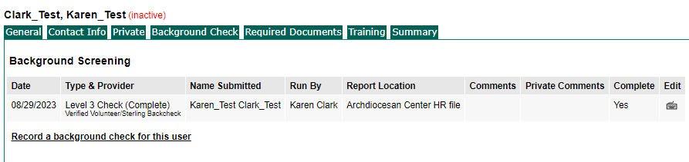
The LSEC will be able to see the completed background check date in the Virtus record for the employee or volunteer.

Slide 22
All school employees and volunteers must complete re-training in child sexual abuse awareness every 5 years.
Live Class Options
(Good for 5 years)
PGC (3 hours)-everyone must take this for their first class.
Online Recertification
(Every year)
Every month: read the bulletin (article) and answer the question at the end.
Every year: complete the online module (45 minutes)
Online module has a certificate
Keeping the Promise Alive (90 minutes)-recertification only
Vulnerable Adults (90 minutes)-recertification only
Each class has a certificate
The date of re-certification is 5 years from the actual date on the certificate. For example, a certificate dated 6/15/2021 will expire on 6/15/2026.

Slide 23
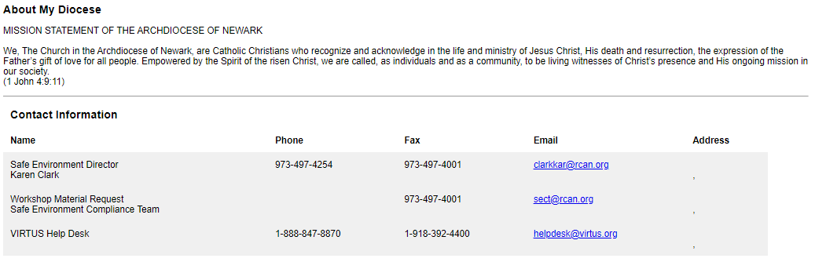
Virtus is your go-to place for compliance; you have Administration authority to your users.

Slide 24
A School Employee or Volunteer application will be based on the date of hire or start of volunteer service.
Start /Hire Date | Application Type
Hired prior to 1/2013 | Original application and pages 5 and 6 of the 2013 Employee
Hired from 1/2013-6/2018 | 2013 Employee
Hired from 6/2018-8/2019 | 2018 “Pass the Trash”
Hired on or after 9/1/2019 | 9/2019 “Pass the Trash”
Volunteers/prior to 2012 | Original application and pages 4 and 5 of the 2012 Volunteer
Volunteers/after 1/2012 | 2012 Volunteer
Student Teachers are not required to complete an application.
Copies of any application are available by emailing sect@rcan.org

Slide 25
Every school employee must have a current fingerprint document in their employee file.
The Applicant Approval Employment History can be accessed using this link:
https://homeroom5.doe.state.nj.us/chrs18/?app-emp-history

Slide 26
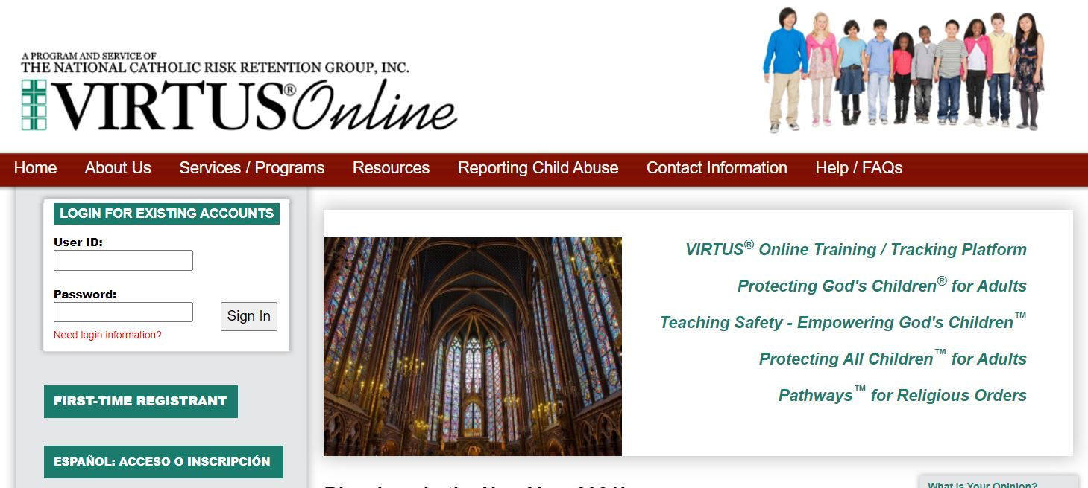
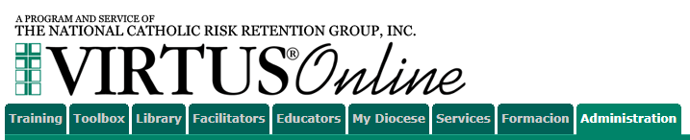
VIRTUS Online
Virtus functions
Administration Tab
How to run a Compliance Report
Updating the list
How to print a PGC certificate
Updating individual records

Slide 27
Virtus allows users to sign themselves up for class, as well as allows you to manage compliance.
New User sign up
Every employee and school volunteer will create an account in Virtus to sign up for a PGC class. The account stays with them and will be used to sign up for recertification classes and/or complete online recertification requirements.
Database
You can run monthly reports to review compliance, as well as determine that all active users are represented, and inactive or deceased users are not in the active user list

Slide 28
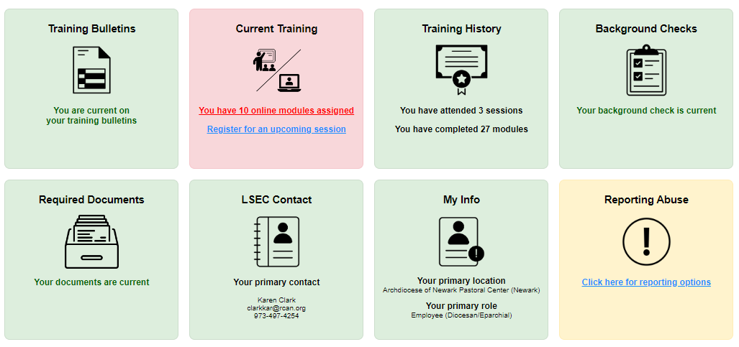
The Virtus Home tab provides an overall look at compliance for each user.

Slide 29
Virtus “Home” Tab explanation.
Users who have opted into online recertification will have all 8 boxes. Box 1 and Box 2 provide access to the monthly bulletins and the annual modules.
Users who are not opted into online recertification will only have 6 boxes (the Training History, Background Checks, Required Documents, LSEC Contact, My Info and Report Abuse boxes).
A Green box means they are compliant with safe environment requirements.
A Red box means they are not compliant. If a user has opted into online recertification, they can click into Box 1 and/or Box 2 and update their training.
Users who have a red Background checks or Required Documents box will need to contact their Local Safe Environment Coordinator to determine what must be updated.

Slide 30
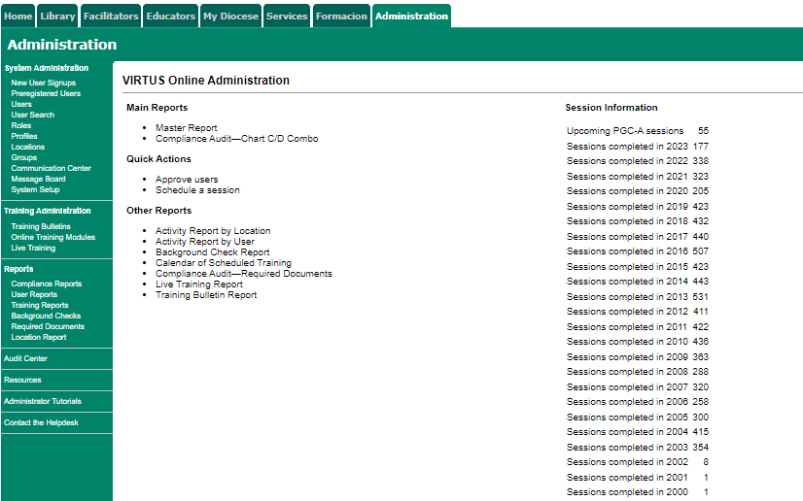
Select “Users” to access school-specific Virtus lists in the Administration Tab.
This Photo by Unknown Author is licensed under CC BY-SA

Slide 31
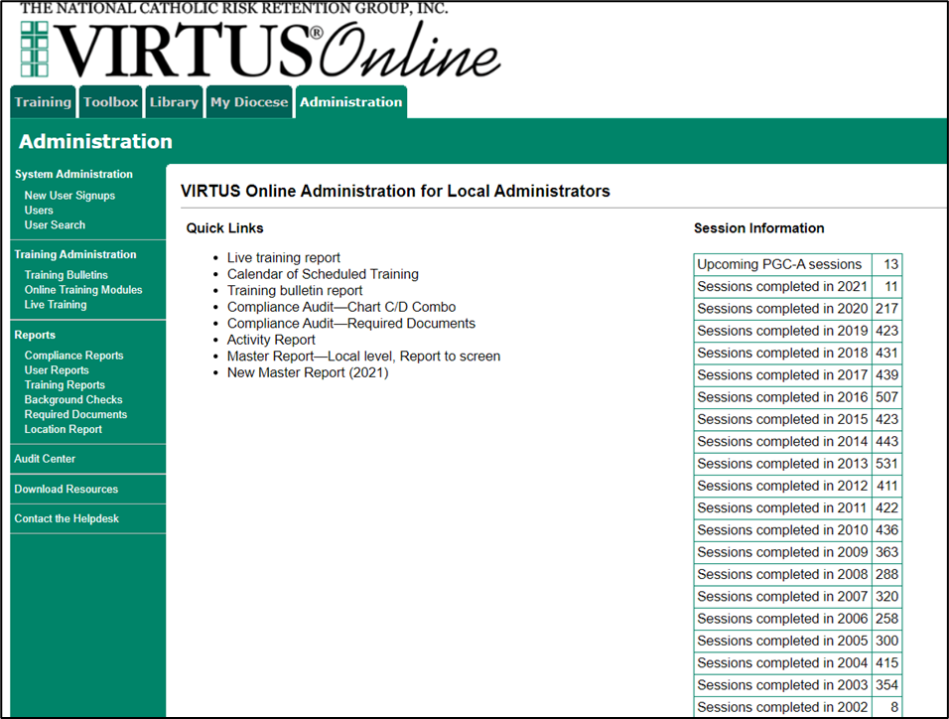
Select “User Search” and all records in the Archdiocese can be searched.
To add a user from a different location to your location, email the username and location to
sect@rcan.org and the OCYP will add the user to your location.

Slide 32
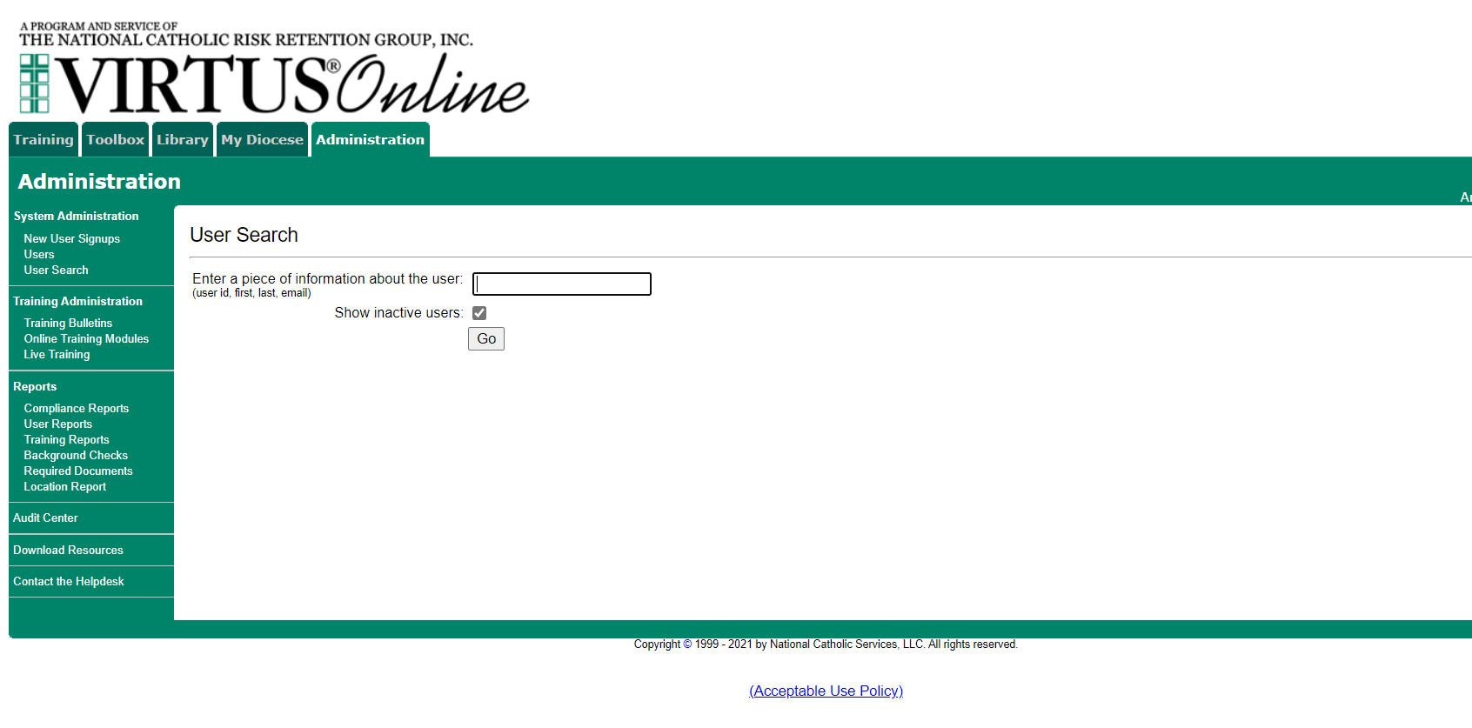
Select “Show Inactive users” to capture everyone in the school or Archdiocese.

Slide 33
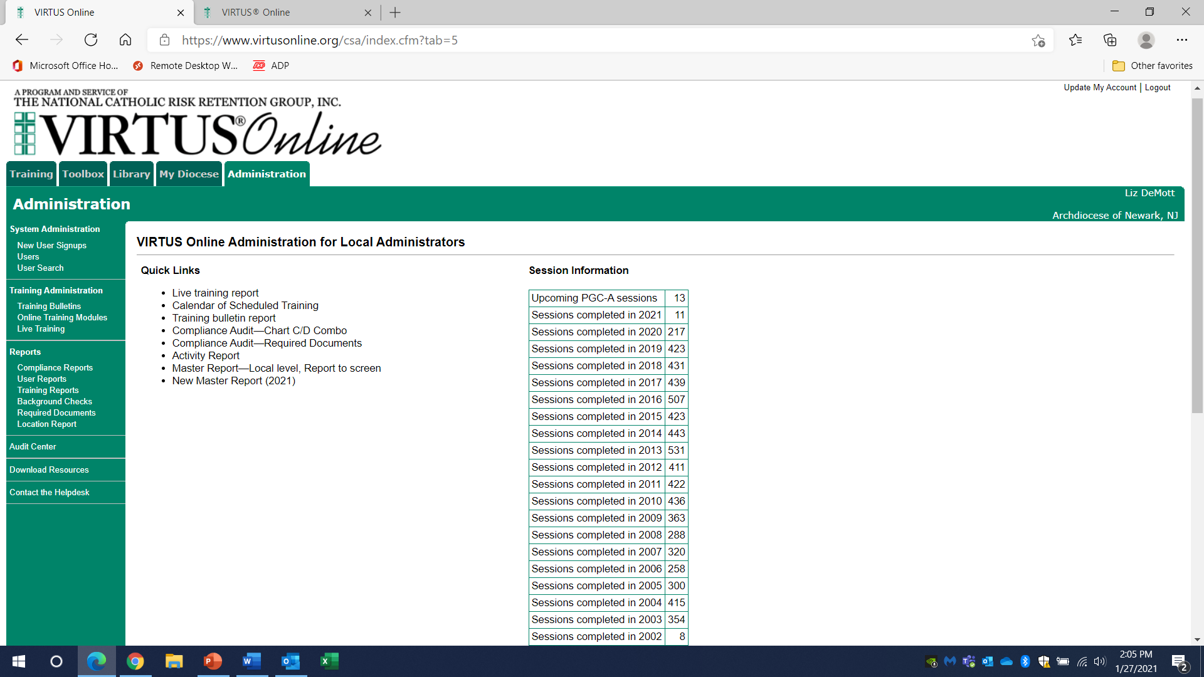
Compliance reports will show who needs recertification and background rechecking, if the data is in Virtus.
LSEC should run a Master Compliance report monthly to review the following:
Background check dates
PGC certification dates
“Pending” users
“Suspended” users
Online recertification compliance
Input any missing dates for compliance items

Slide 34
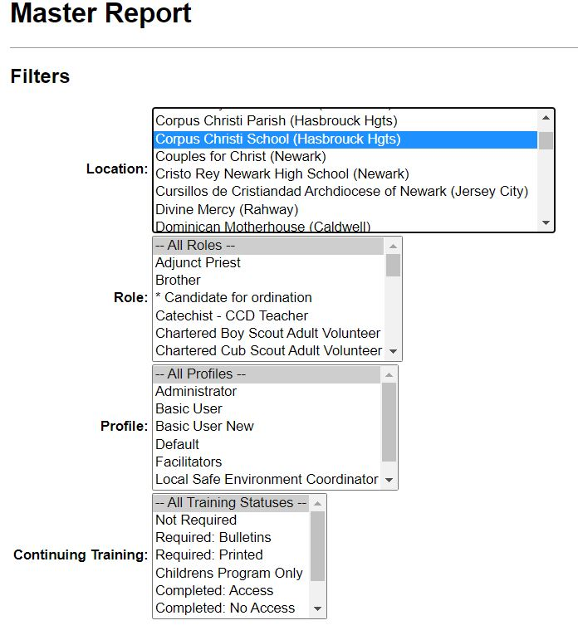
How to Run a Master Compliance Report
Step 1> Select the Filters
Location>Your specific location
Role>All Roles
Profile>All Profiles
Continuing Training>All Training Statuses

Slide 35
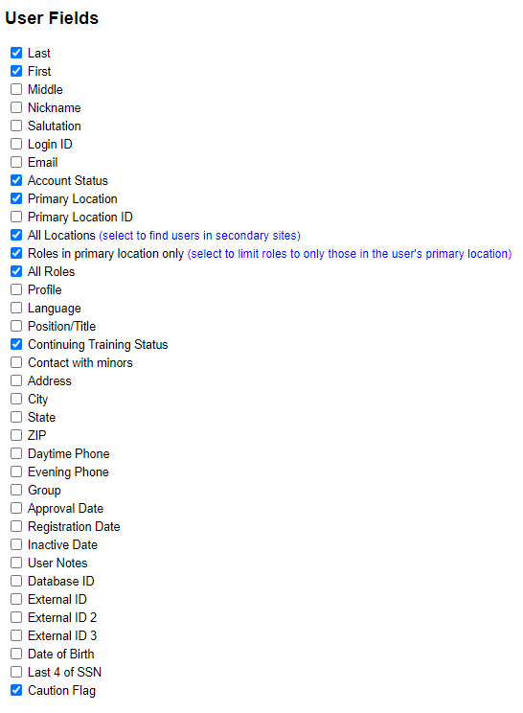
Step 2 > Select the User Fields
LSEC can select any of the fields listed if you need additional information (email address, telephone). If the information is not in Virtus, it will not appear on the report.
Account Status will indicate if user is Active, Inactive, or Pending.
The Caution Flag will provide information regarding issues that need to be addressed by the OCYP. If you see information in the Caution Flag field, please contact the OCYP by email sect@rcan.org.

Slide 36
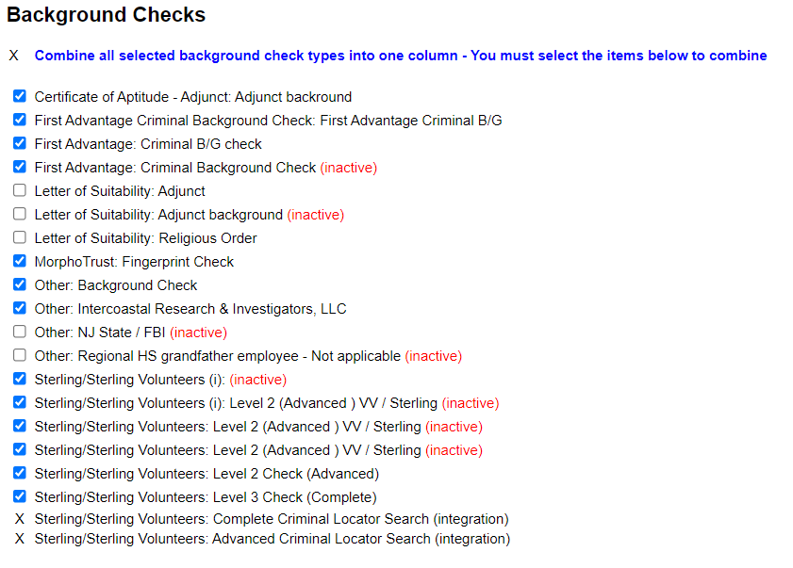
Step 3> Select the Background Checks fields
To view older background check information, simply select more fields.
Note: MorphoTrust was changed to Idemia in July 2019. This name change has not yet been reflected in Virtus.

Slide 37
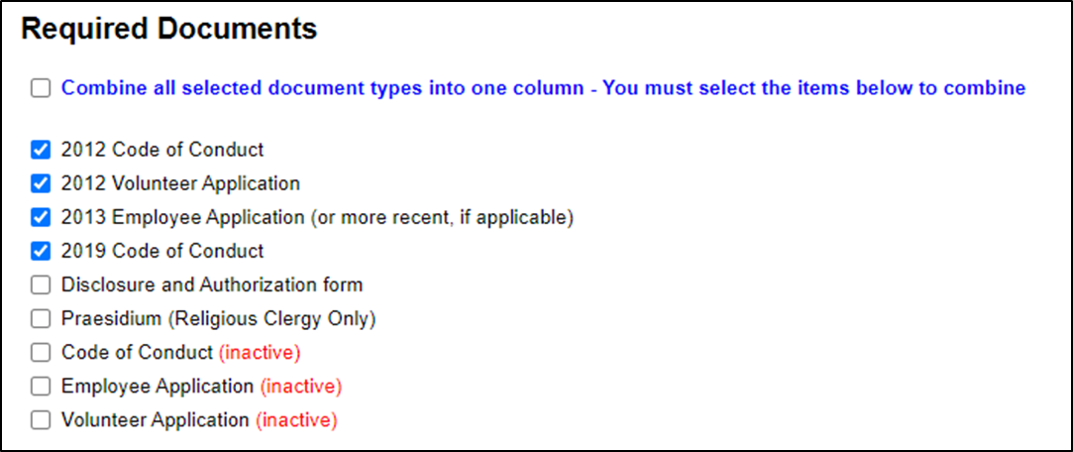
Step 4> Select the Required Documents fields
Employees or volunteers starting on or after January 1, 2019 will complete the 2019 Code of Conduct.
New school employees starting after June 1, 2018, will complete the 2018 “Pass the Trash” Employment Application.
New employees starting after September 2019 will complete the September 2019 Employee Application.
Notes:
Updated screen shot for Required documents

Slide 38
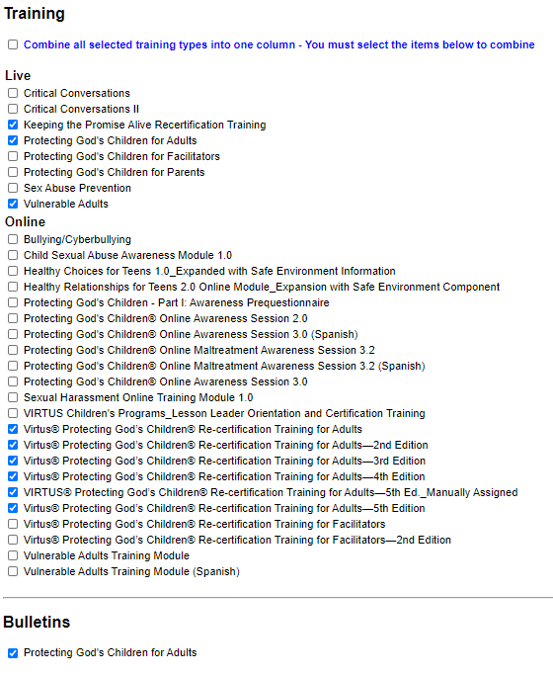
Step 5> Select the Training fields
Notes:
Updated the smart graphic to match on both guides

Slide 39
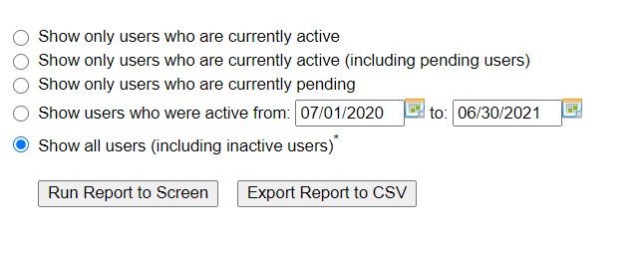
Step 6> Select the report period and report format.
Run Report to Screen – not recommended for printing. Good option to review the report and make edits to individual records.
Export Report to CSV- report can be saved in Excel and is easier to review and work with the data.
Notes:
Updated screen shot

Slide 40
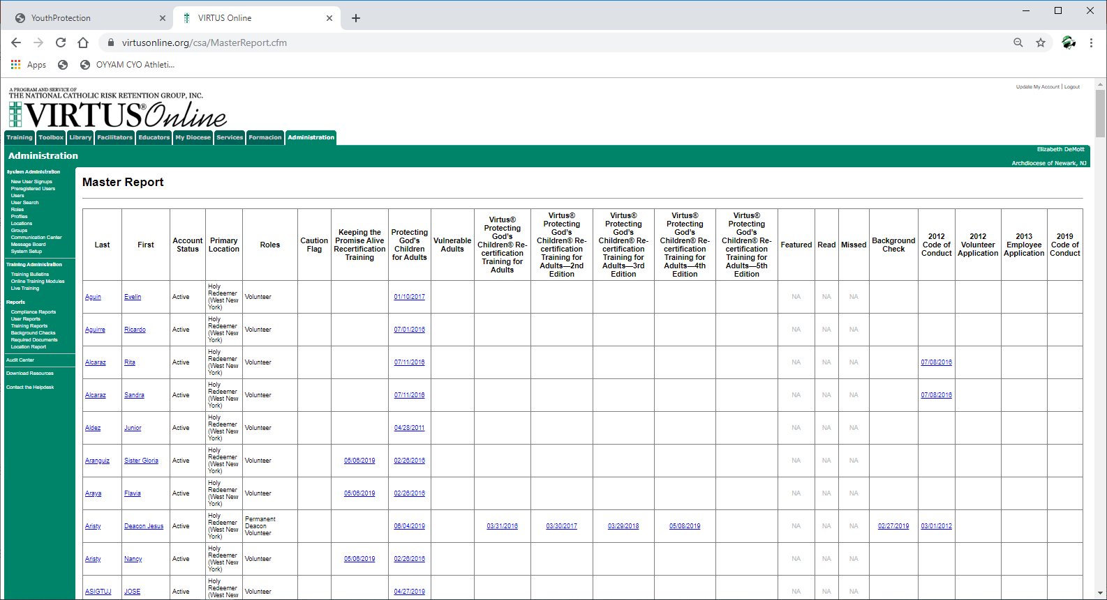
“Run Report to Screen” looks like this.
Run Report to Screen will allow access to each user record. Click anywhere there is a blue hyperlink, and it will open the individual user record. Edits can be made directly in the user record.

Slide 41
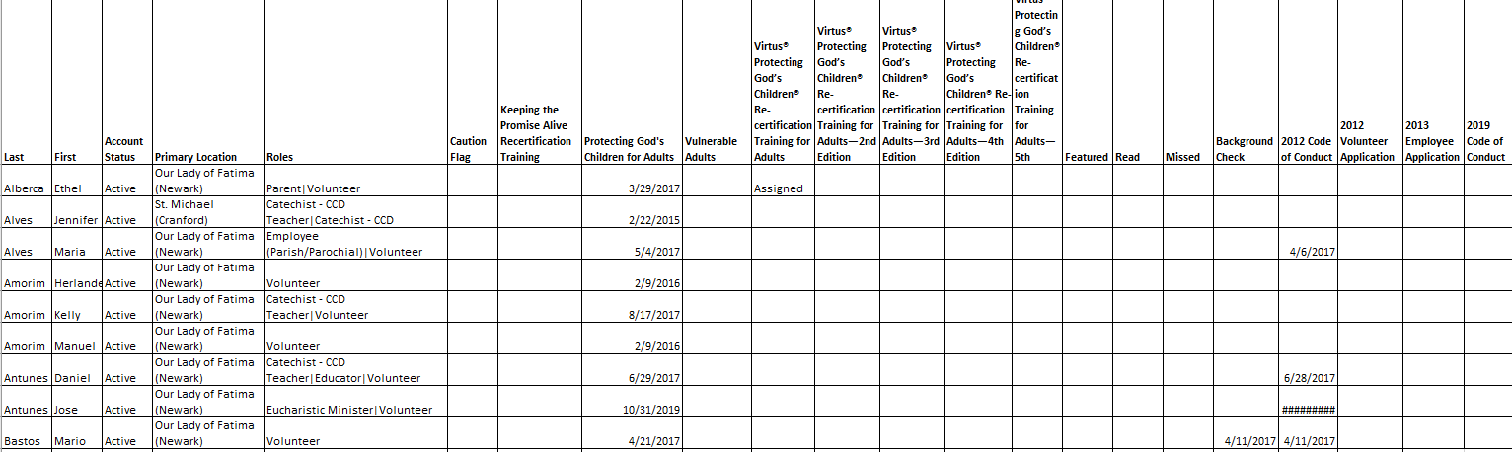
The Master Compliance Report will look like this Export Report to CSV is selected.

Slide 42

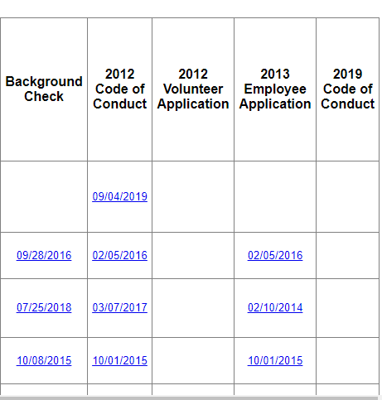
There should be dates from your files for the Code of Conduct, application and background check so the information is retained in the Virtus database.
Background checks:
If volunteer runs it at integration, the date will automatically populate.
Otherwise, the date must be manually entered.
Application dates will be manually entered by POTF when we receive packet.
If a field is blank, check may not have been done – check the files.

Slide 43
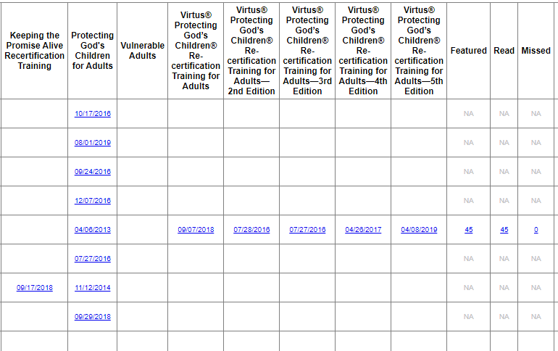
The next section shows the training dates, whether they have opted in for online recertification, and how they’re doing at keeping up.
This person recertified by taking a live class
This person is recertifying online and is up to date with both the annual module and the monthly bulletins.

Slide 44
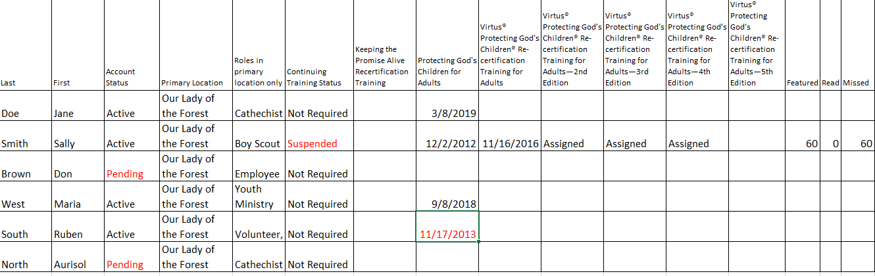
How to review the Training information. (LSEC will review monthly).
Sally Smith- Suspended because she missed 60 months of bulletins. Users who opt in for online recertification and do not keep up with the monthly bulletins and annual module get Suspended after 18 missed bulletins. They have 2x to try and keep up. After that, they must attend a live class to recertify.
Don Brown-Pending because he signed up to attend PGC but did not receive credit (see next slide for examples). Contact sect@rcan.org for assistance.
Ruben South- PGC certification expired on 11/17/2018. He must recertify.

Slide 45
What is the difference between a Pending and an Active status?
“Pending” means that they enrolled in Virtus to attend PGC, but never had their enrollment approved because:
They didn’t show up for the class
The sign in sheet never made it to the Archdiocese
The class hasn’t happened yet
They walked into class and enrolled later, and didn’t let OCYP know they had done that
Once they get approved by the OCYP, their status changes to Active (Active on the Compliance Report)

Slide 46
For the Virtus lists, it’s important to get down to only those people who are active in the school.
Get lists of current people (employees, coaches, Commission employees, etc. )
Active people are the only ones who should be on your Virtus lists and in your Active Files (others can be filed elsewhere but must be retained)
Virtus List Management:
Duplicates: Email the names of any duplicates on your list to the OCYP, and we will delete them or merge them.
For any individuals who are Pending/Awaiting Approval, email the names to the OCYP for resolution
Change status from Active to Inactive (or vice versa)
Notes:
Pending/Awaiting Approval people- clarify this point because shouldn’t only the OCYP be responsible for this?
Recommendation: For any individuals who are Pending/Awaiting Approval, email the names to the OCYP for resolution.

Slide 47
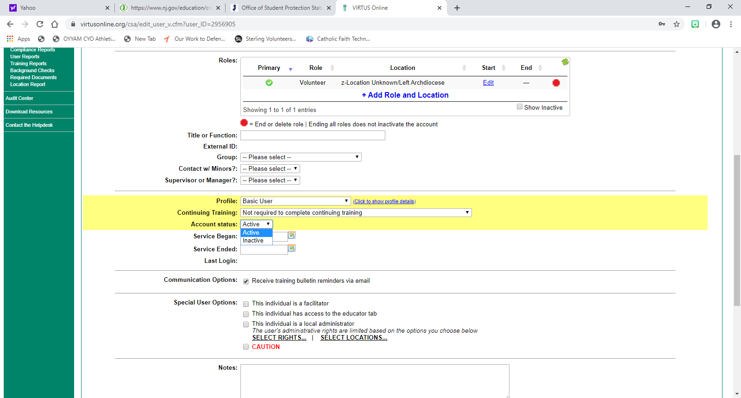
How to Update a User Role and Location.
If an individual is not volunteering at this point: Change the Account status (in the yellow area) to Inactive – but ONLY if yours is the only location in their record. Account status can also be changed back to “Active” at any time.
If the individual is at multiple locations, just end their service at your location by clicking on the red stop sign . Clicking the red stop sign will completely remove the individual from your location.
If an individual is temporarily inactive, change their Role to “Z-Missing Role”. Once they return, change the role to the correct new role.
Notes:
Added: Note: LSEC’s only have access to their main location in Virtus. If access to an additional location is needed (for parishes that have a school close by), contact the OCYP at sect@rcan.org.

Slide 48
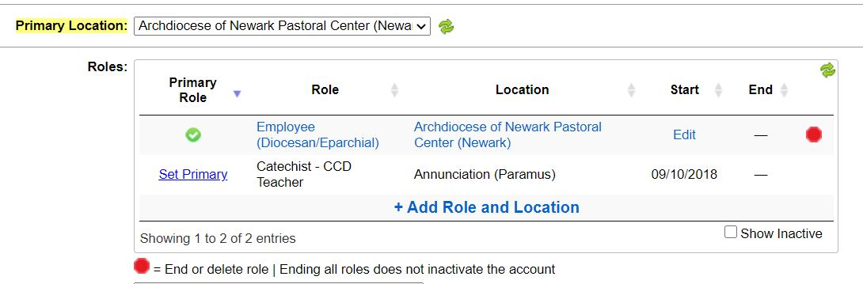
To Change the “Role” or “Location”
Click on the blue hyperlink
LSEC’s only have access to their main location in Virtus and will only be allowed to make changes to individuals assigned to that location.
If access to an additional location is needed (for schools that have a parish close by), contact the OCYP at sect@rcan.org.

Slide 49
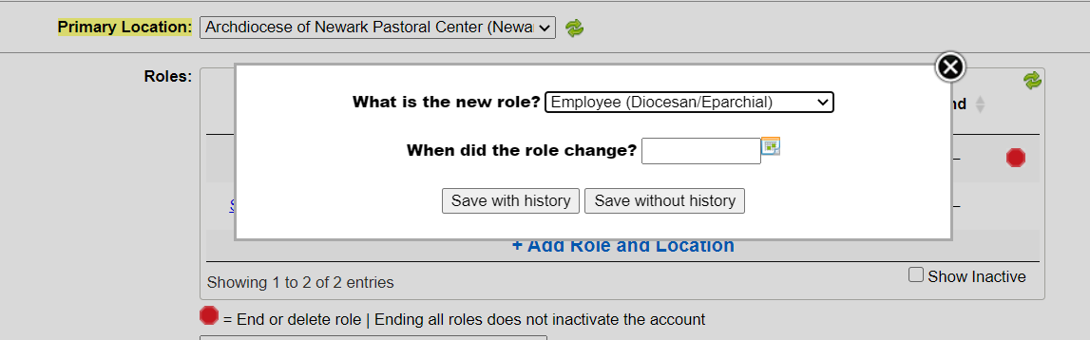
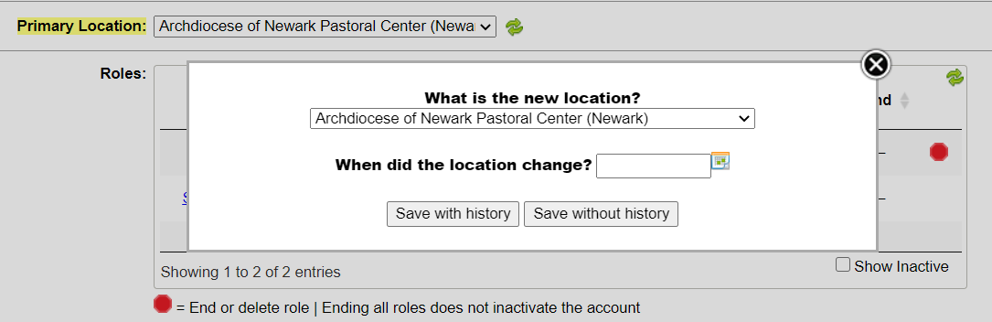
Select the new role from the drop-down menu
Click “Save with History”
Complete the same process for “Location” if necessary

Slide 50
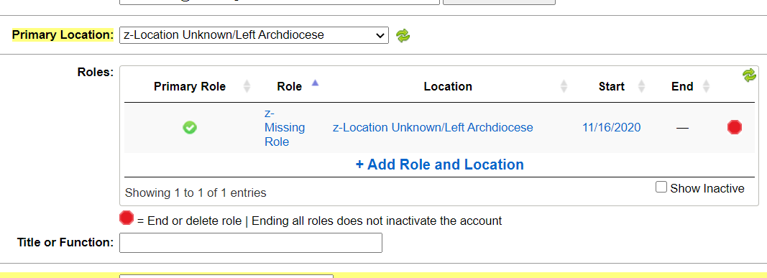
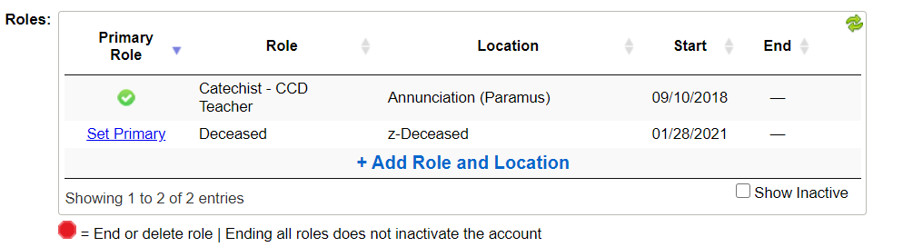
Change the Role and the Location for any individuals no longer at your location, deceased, or have permanently left the Archdiocese.

Slide 51
If a person took Protecting God’s Children in another diocese, they must have their record transferred to Newark. Contact the OCYP for help.
Each diocese has its own Virtus system – the OCYP does not have access to other dioceses (Metuchen, Paterson, etc.)
The OCYP can do the following:
  Have the PGC record transferred to Newark (email a copy of the PGC certificate to the OCYP).
  If they still volunteer in the other diocese, the OCYP will have the PGC record duplicated in Newark.
  Email the name and copy of the certificate to the OCYP (email to sect@rcan.org) so we can resolve.
Notes:
Added OCYP email address to last bullet point

Slide 52
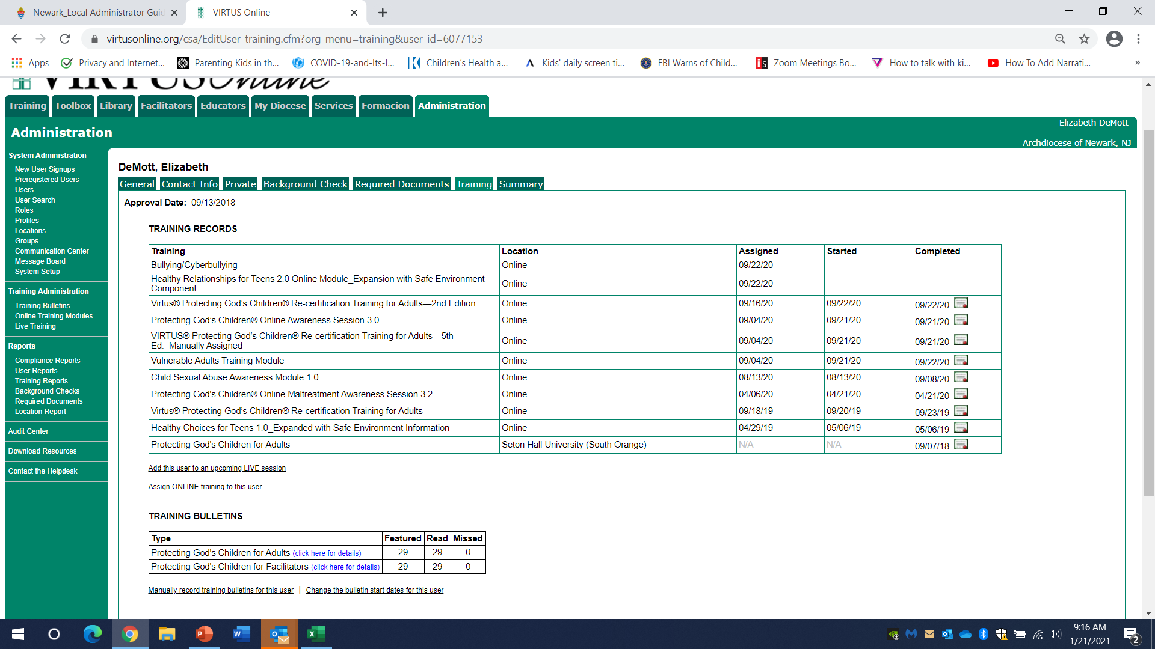
PGC training certificates can be printed from Virtus.
If you need a certificate, print it from the Training tab by clicking the little certificate icon. LSEC can sign and file it.

Slide 53
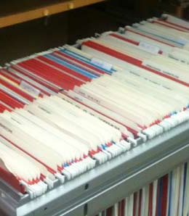
Once we receive the packet for the background check, we will enter the dates from the required documents and background check into Virtus.
The date the employee/ volunteer application was signed.
The date the Code of Conduct was signed.
The date the background check was completed.

Slide 54
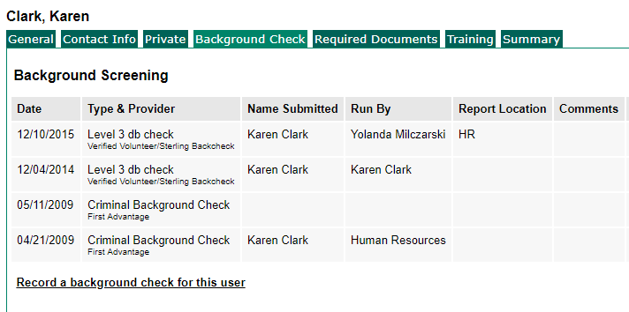
To add fingerprint date to Virtus:
Select the “Background Check” tab > “Record a background check for this User”.

Slide 55
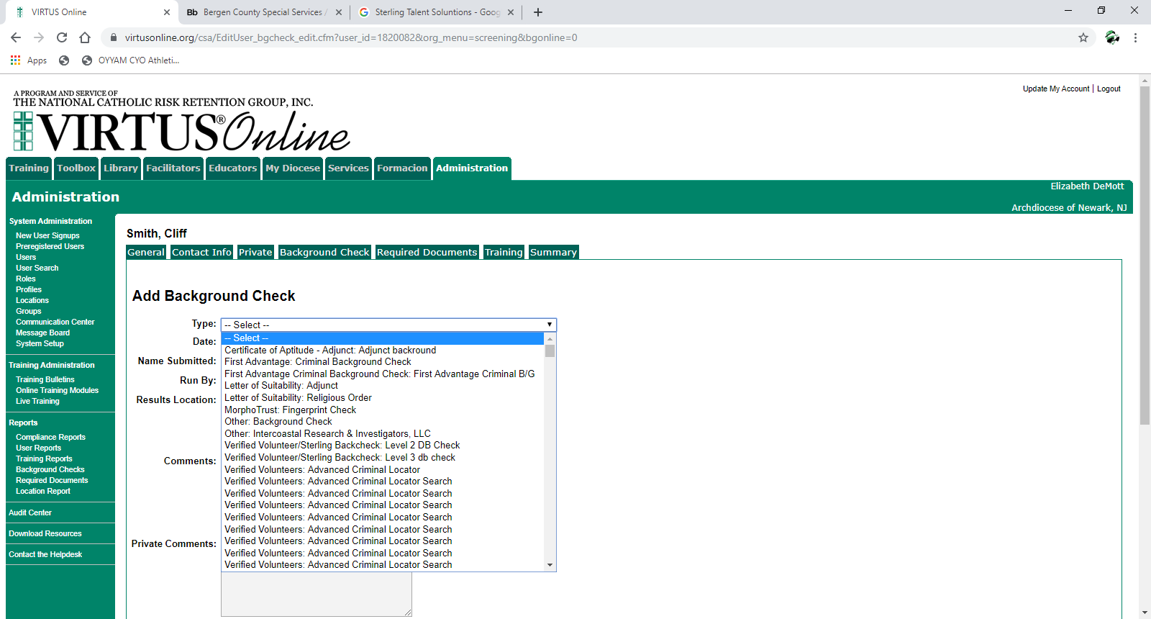
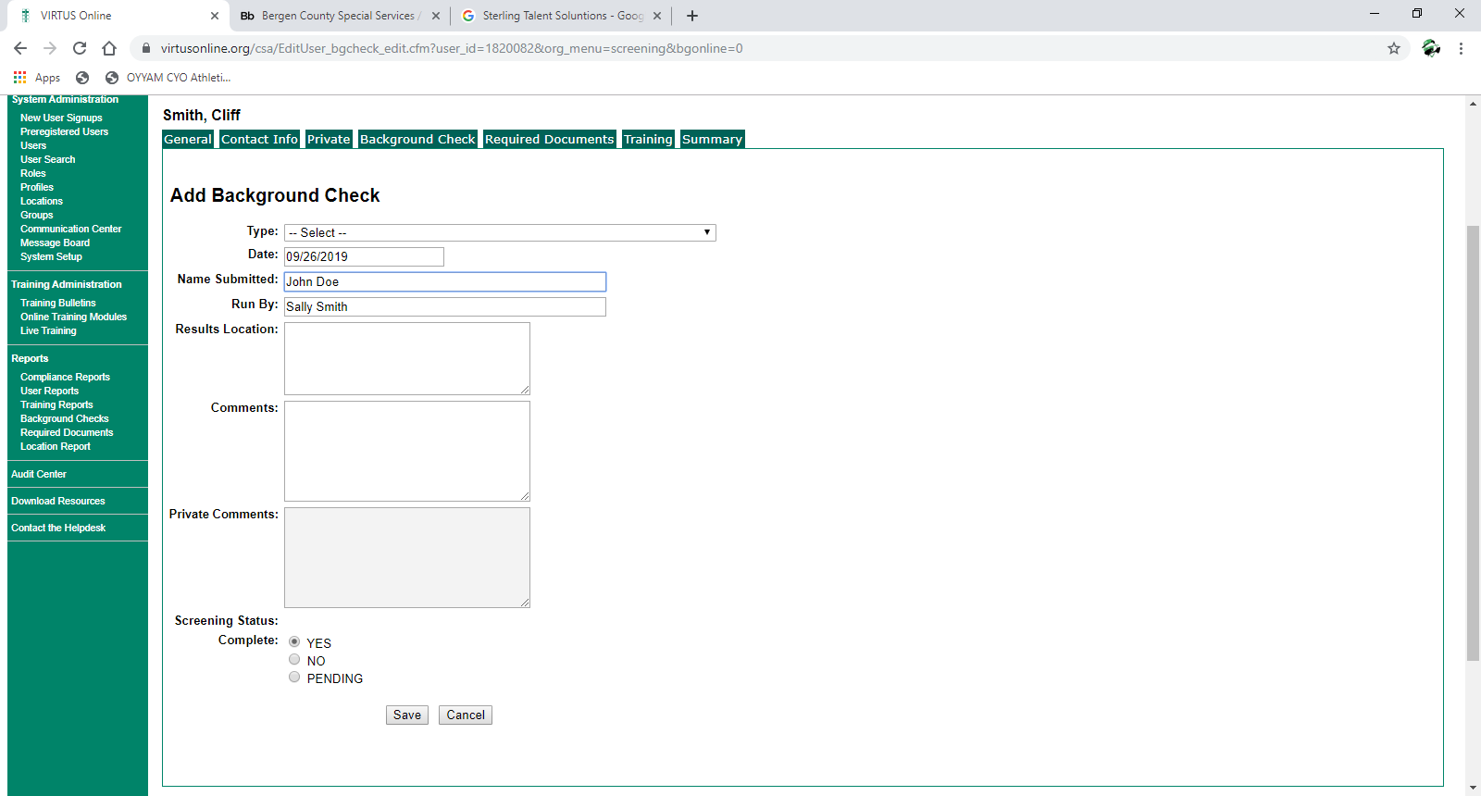
Add the approval date from their NJ DOE Applicant Approval Employment History.
Add Date
Run By: LSEC Name
OR
State of NJ (for fingerprints)
Select “Type”-see next slide for correct Type selections
Click “Save”
Notes:
Edit this slide-should be 2 slides

Slide 56
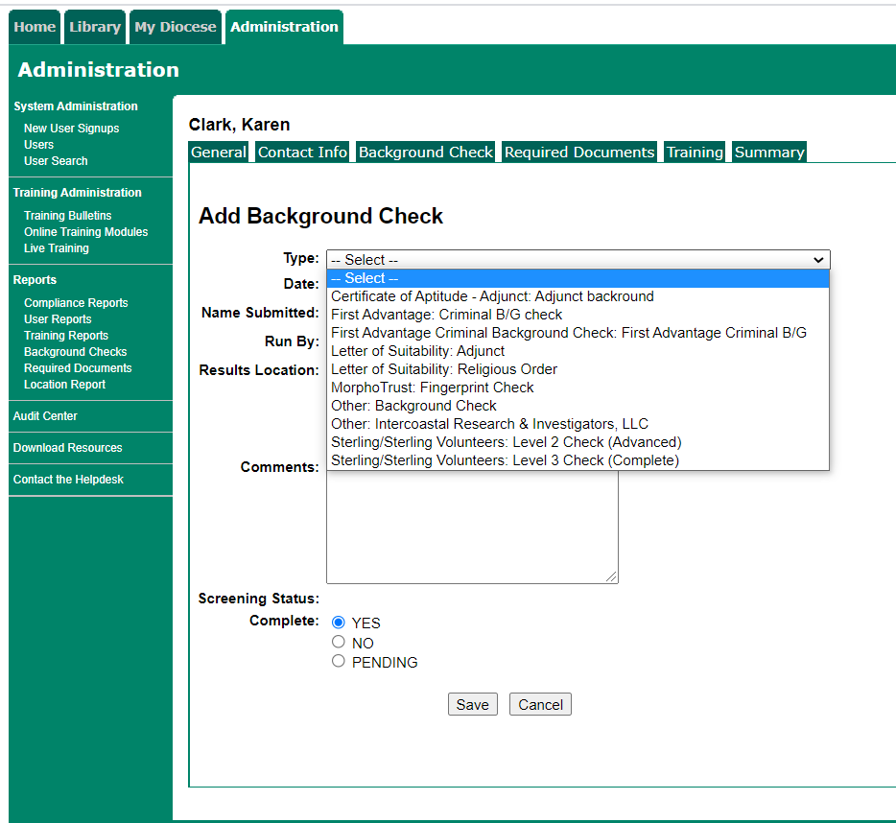
Choose the correct “Type” of background check from the drop-down menu.
MorphoTrust: Fingerprint Check is only for current NJ school employees.
Notes:
Edit this slide-should be 2 slides

Slide 57
To record this information in Virtus:
Type: MorphoTrust/Fingerprint Check
Date Submitted: Approval Date at current location
Run By>State of NJ
The Applicant Approval Employment History can be accessed using this link: https://homeroom5.doe.state.nj.us/chrs18/?app-emp-history

Slide 58
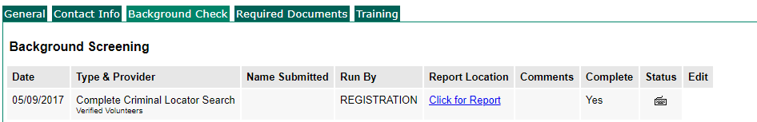
Volunteers who completed their background check themselves through Integration (when they first signed up in Virtus) will have it already entered in Virtus.
Send us the packet for these users, which gives us permission to view the results and write a letter.

Slide 59
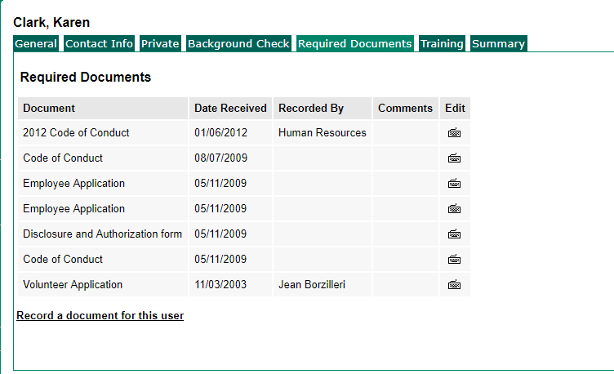
How to Record a Document in Virtus:
Go to Required Documents>“Record a Document for this User”

Slide 60
Sterling costs vary depending on where the person has lived, and if the person possesses a Social Security Number.
All volunteers are required to provide their Social Security Number and Date of Birth. This is also true for emergent hires whose fingerprint date is after their start date. Cost for these checks through Sterling is $21.20.
For those volunteers who don’t have a Social Security Number, you MUST vet them locally, and the charge for the check is about $10.
Any county that charges for access to their database will be charged separately – for many local NY Counties this is $95 Per Alias
Volunteers can contribute to the cost if you ask us to send them a link directly, and they complete their own background check.
The school is invoiced monthly for the costs of the background checks; the school is responsible for the cost

Slide 61
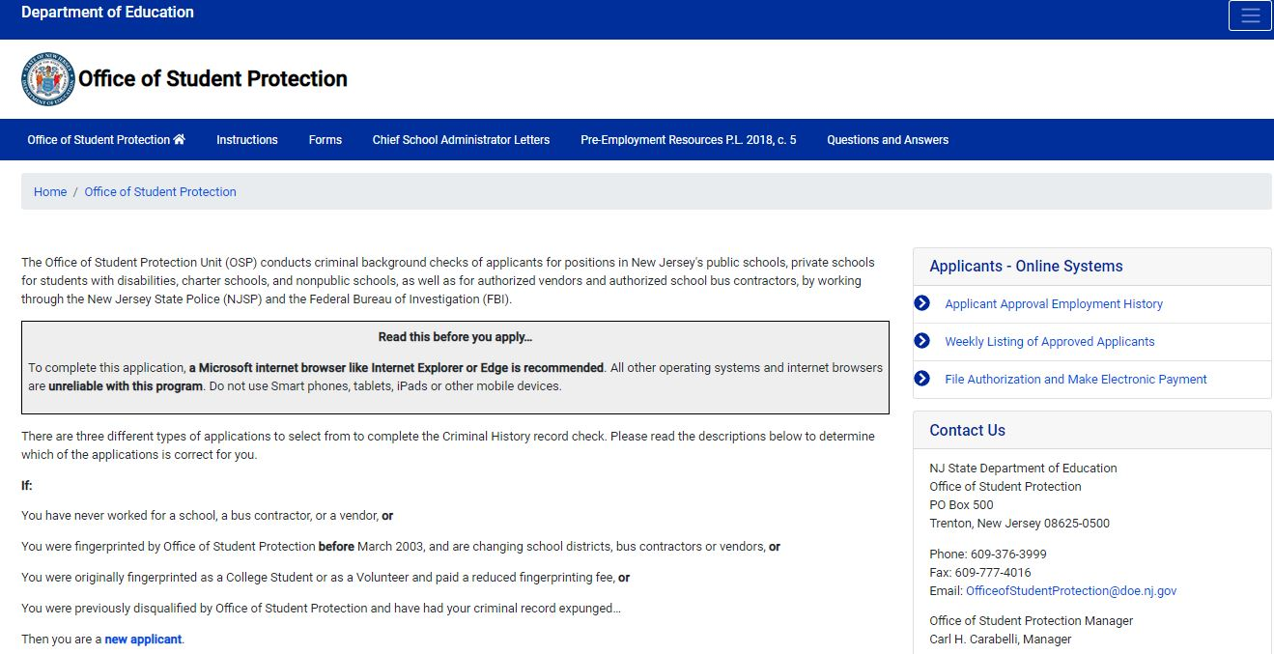
The NJ DOE Office of Student Protection has all the information regarding fingerprint requirements.
https://www.nj.gov/education/crimhist/

Slide 62
Applicant Approval Employment History example.
The Applicant Approval Employment History can be accessed using this link: https://homeroom5.doe.state.nj.us/chrs18/?app-emp-history

Slide 63
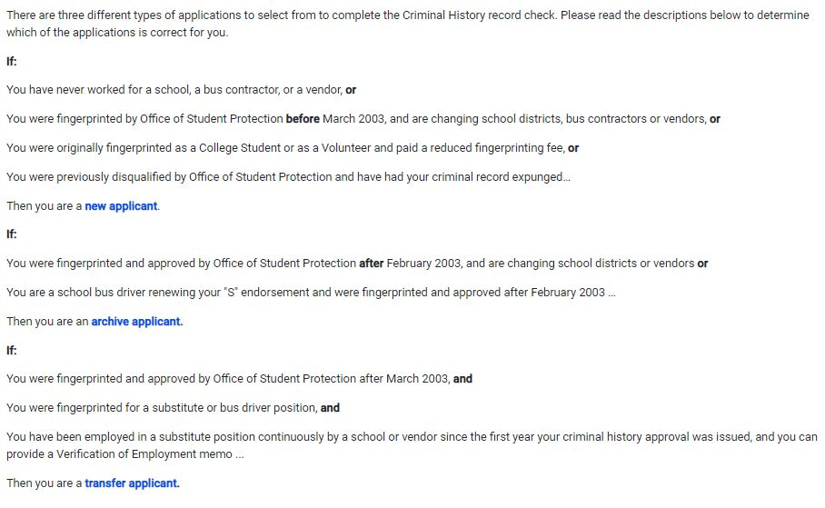
Individuals employed at a school must have fingerprints on file at the correct location.
Changing school districts? Follow the archive applicant procedures. Cost is $29.75.
Substitute teacher or a teacher in multiple locations? Follow the transfer applicant procedures. Cost is $6.00.

Slide 64
All active school volunteers must be re-screened every 5 years.
Run a Master Compliance report to see who needs a background check at the beginning of each calendar year or school year (assuming the dates are in Virtus)
Make sure you have a volunteer application on file and that all pages are filled out and initialed where indicated, specifically the last 2 pages. If the “Notice Regarding Credit Reporting Agency Check” page is not initialed, the background check cannot be run.
Send a packet (cover sheet, application, Code of Conduct, and PGC certificate) to sect@rcan.org or fax to (973)497-4001

Slide 65
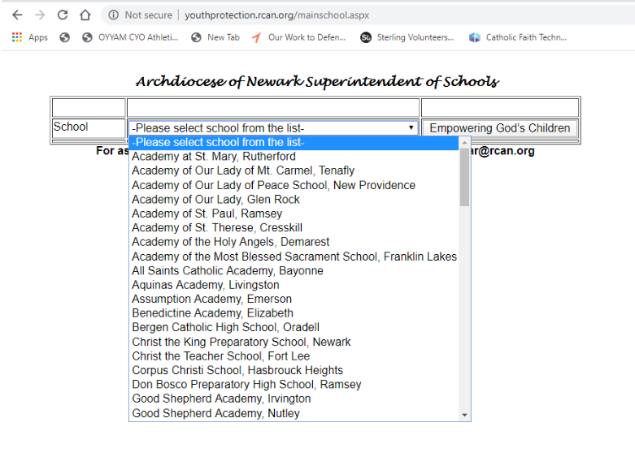
Empowering God’s Children Audit must be submitted by April 15th.
Access audit at this address: http://youthprotection.rcan.org/mainschool.aspx.
Link is also posted on the Empowering God’s Children web page at rcan.org.
This Photo by Unknown Author is licensed under CC BY-SA

Slide 66
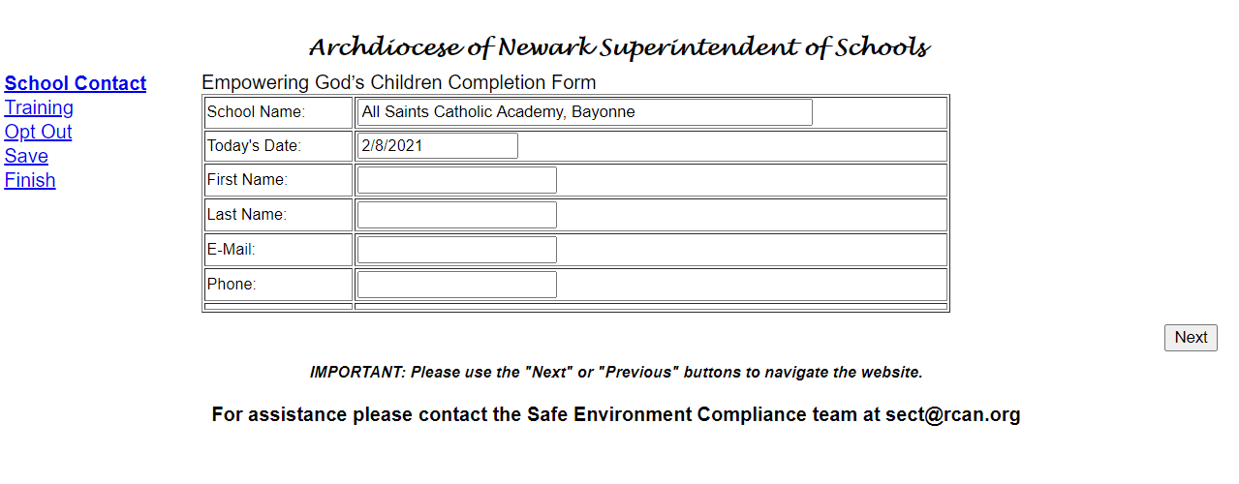
Empowering God’s Children Audit
School Contact
Enter the name of the school contact (LSEC or Principal), email and phone. Click “Next”
This Photo by Unknown Author is licensed under CC BY-SA

Slide 67
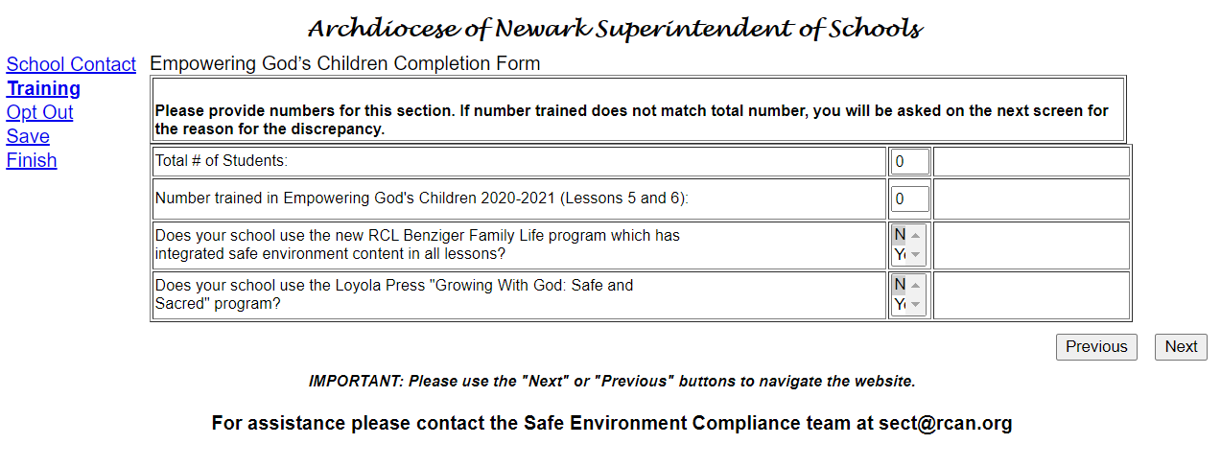
Empowering God’s Children Audit
Training
Enter Total # of Students
Enter Number Trained in Empowering God’s Children
Answer the 2 questions “Y” or “N”
This Photo by Unknown Author is licensed under CC BY-SA

Slide 68
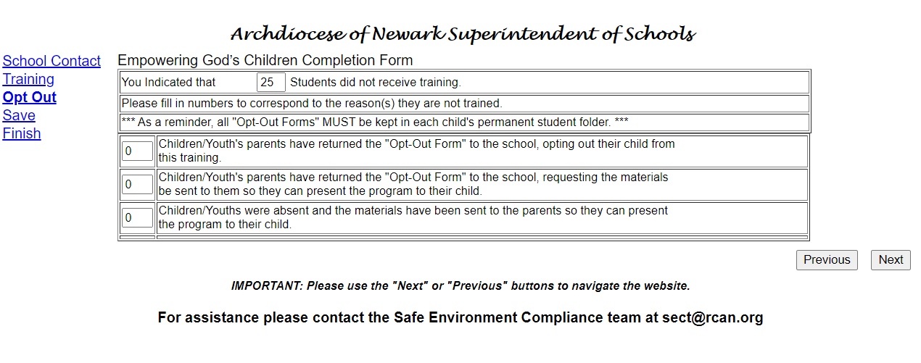
Empowering God’s Children Audit
Opt Out
If there are students who did not receive training, explain how many for each option.
This Photo by Unknown Author is licensed under CC BY-SA

Slide 69
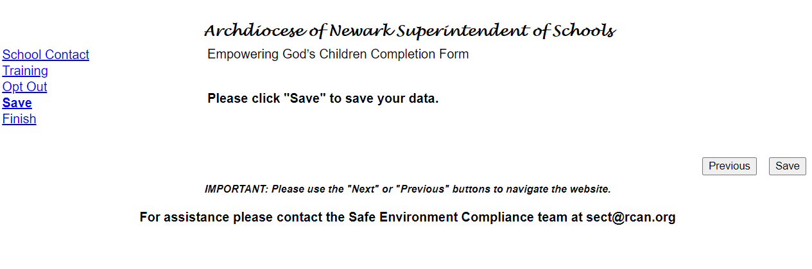
Empowering God’s Children Audit
Must be submitted by April 15th.
Click “Save” and the next screen will allow a “Print to Mail”. Print the document, have the principal sign it and FAX it to 973-497-4001 or scan/email to sect@rcan.org.
This Photo by Unknown Author is licensed under CC BY-SA

Slide 70
Appendix- Sample Documents
2012 Volunteer Application
2013 Employee Application
2018 “Pass the Trash” Application
2019 Employee Application
2019 Code of Conduct
Background check letter
Copies of any documents are available by emailing sect@rcan.org

Slide 71
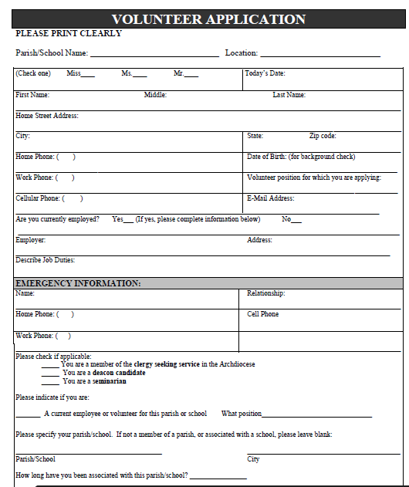
All Volunteers will complete the 2012 Volunteer application.
Make sure application is signed, dated and initialed.
Volunteer must provide an Emergency Contact.
There are 3 questions regarding Criminal History on page 3 of the application- these must be answered “Yes” or “No”! A response of “N/A” is not acceptable.

Slide 72
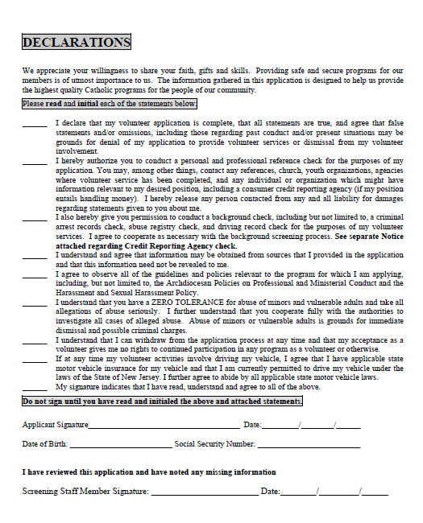
The declaration page must be initialed, signed and dated.
Initial all lines (checkmark is not valid)
LSEC will review and ensure all information is complete.

Slide 73
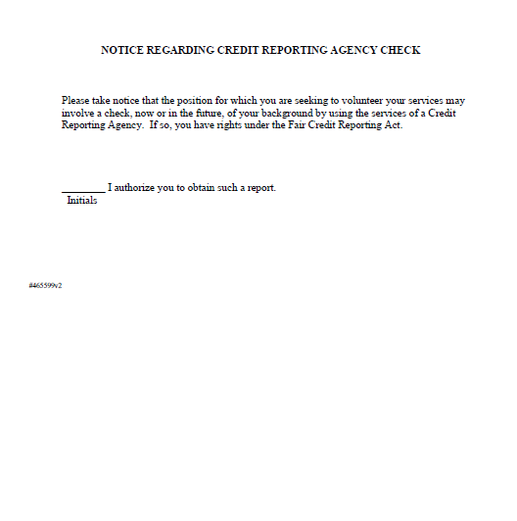
The last page must be initialed. This is required to allow a background check to be run. This is NOT a financial check.
Can the Archdiocese obtain financial information about me?
No. We are barred from any access to your financial information. In fact, if anyone accesses your credit report without your permission, that is a violation of law and you should notify the
Federal Trade Commission immediately.
Notes:
I pulled the question from the Archdiocese of New York website. The verbiage can be changed if it isn’t appropriate to include here.

Slide 74
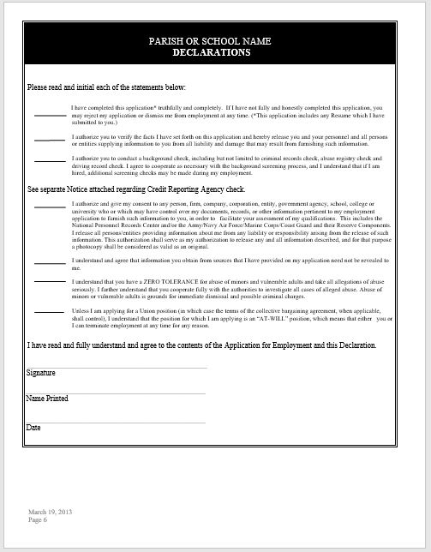

Employees who have an application prior to 2013, must complete the last 2 pages of the 2013 Employee application.
Correct application date is March 19, 2013.

Slide 75


2018 “Pass the Trash” Application – for school employees hired on or after June 1, 2018.

Slide 76


2019 “Pass the Trash” Application – for school employees hired on or after September 1, 2019.

Slide 77

2019 Code of Conduct (in English and Spanish) can be accessed on rcan.org>Protect/Report>FAQ
All employees and volunteers must read the Code of Conduct and sign page 23. The signed copy will be retained in the employee or volunteer file.
Notes:
Updated header, changed screen shot

Slide 78
Once we receive the packet for the background check, we will enter the dates from the required documents and background check into Virtus.
The date the employee/ volunteer application was signed.
The date the Code of Conduct was signed.
The date the background check was completed.

Slide 79

Each employee (emergent) and volunteer (who has a background check) will receive a letter from our team (once you’re centralized).
Emergent Employees and volunteers are required to have this letter in their file as proof that the background check was run.

Slide 80

Thank you for protecting the faithful!

